Slide 1



2023 NJDEP HAB Strategy and Results
By: Emily Mayer, M.S.
Research Scientist

Slide 2

NJDEP HAB Strategy
Primary focus is:
Statewide approach to respond to cyanobacterial HABs
Freshwater recreational waters and sources of drinking water.
Protection of human health (risks associated with cyanobacteria and related toxins)
Some information and recommendations regarding exposure:
  domestic animals (pets), livestock, and wildlife, as well.

Slide 3
NJDEP HAB Strategy
Entities responsible for response and actions
Recreational risk thresholds and appropriate responses to protect public health and safety
Acceptable parameters and methods for assessing risk
Appropriate monitoring and analysis to identify cyanobacteria, enumerate cells and determine concentrations of cyanotoxins, and
• HAB Alert Levels/ Advisory

Slide 4
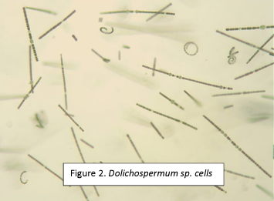
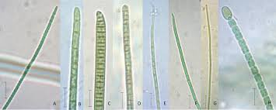
Cyanobacteria
Cyanobacteria are ancient microbial life form which are thought to be responsible for oxygenating the Earth 2 - 4 BYA
Cyanobacteria can be found in a variety of aquatic and terrestrial ecosystems
They are true bacteria – (aka blue-green algae)
Function like true algae in aquatic systems, they are often considered to be part of the algal community
The most frequent and severe non-tidal surface freshwater blooms are caused by cyanobacteria

Slide 5


Health Risks
Allergic–like reactions (e.g., rhinitis, asthma, eczema, and conjunctivitis)
Flu–like symptoms, gastroenteritis, respiratory irritation, skin rashes, and eye irritation can occur through primary recreational exposure to cyanobacterial cells.
Pet and livestock are at risk

Slide 6
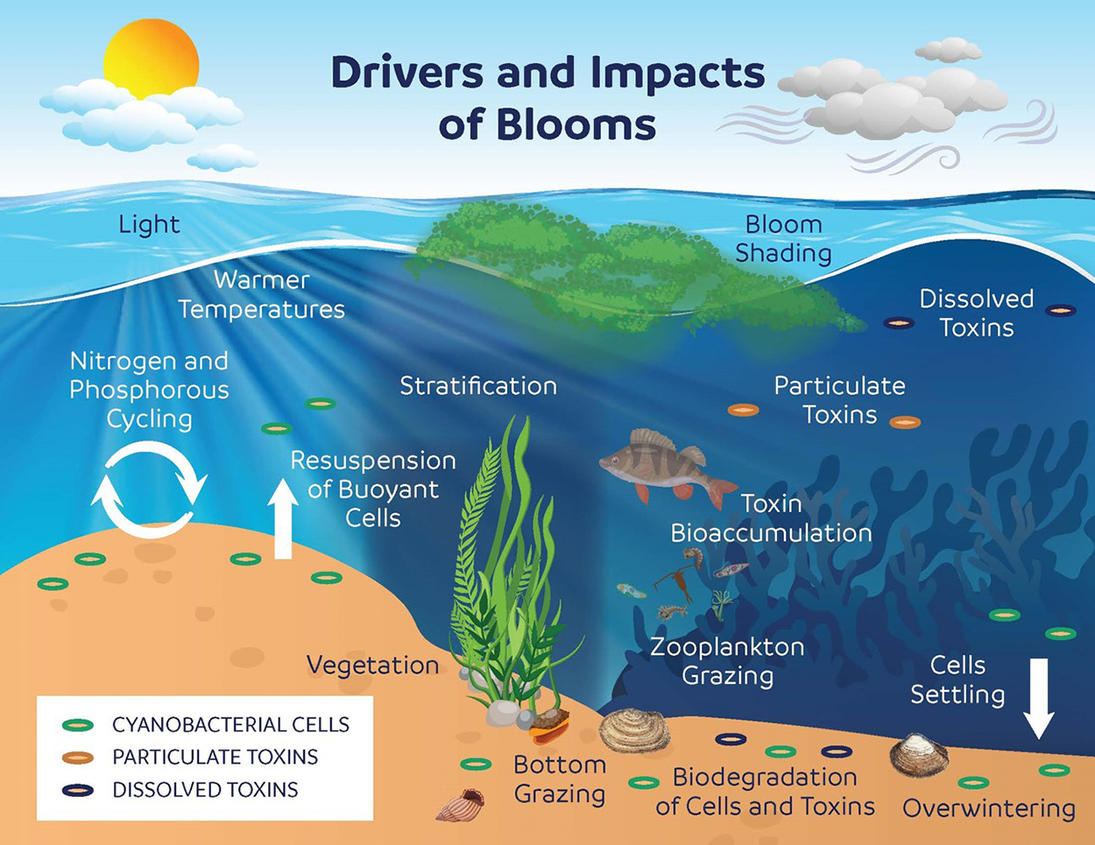

Slide 7
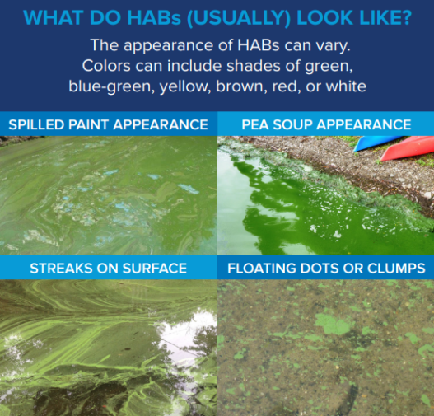
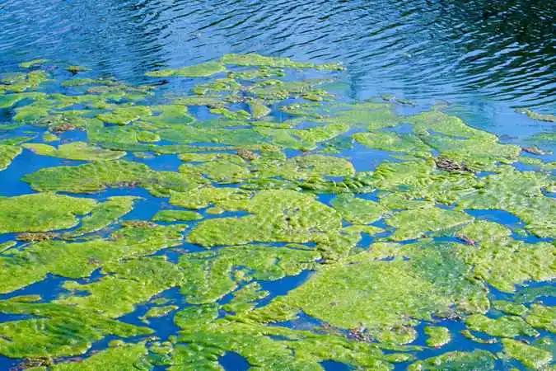
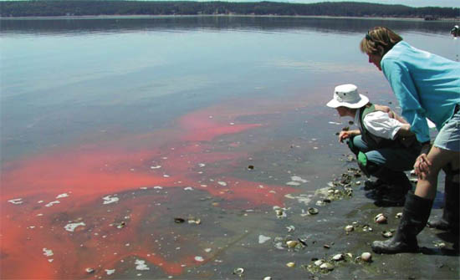
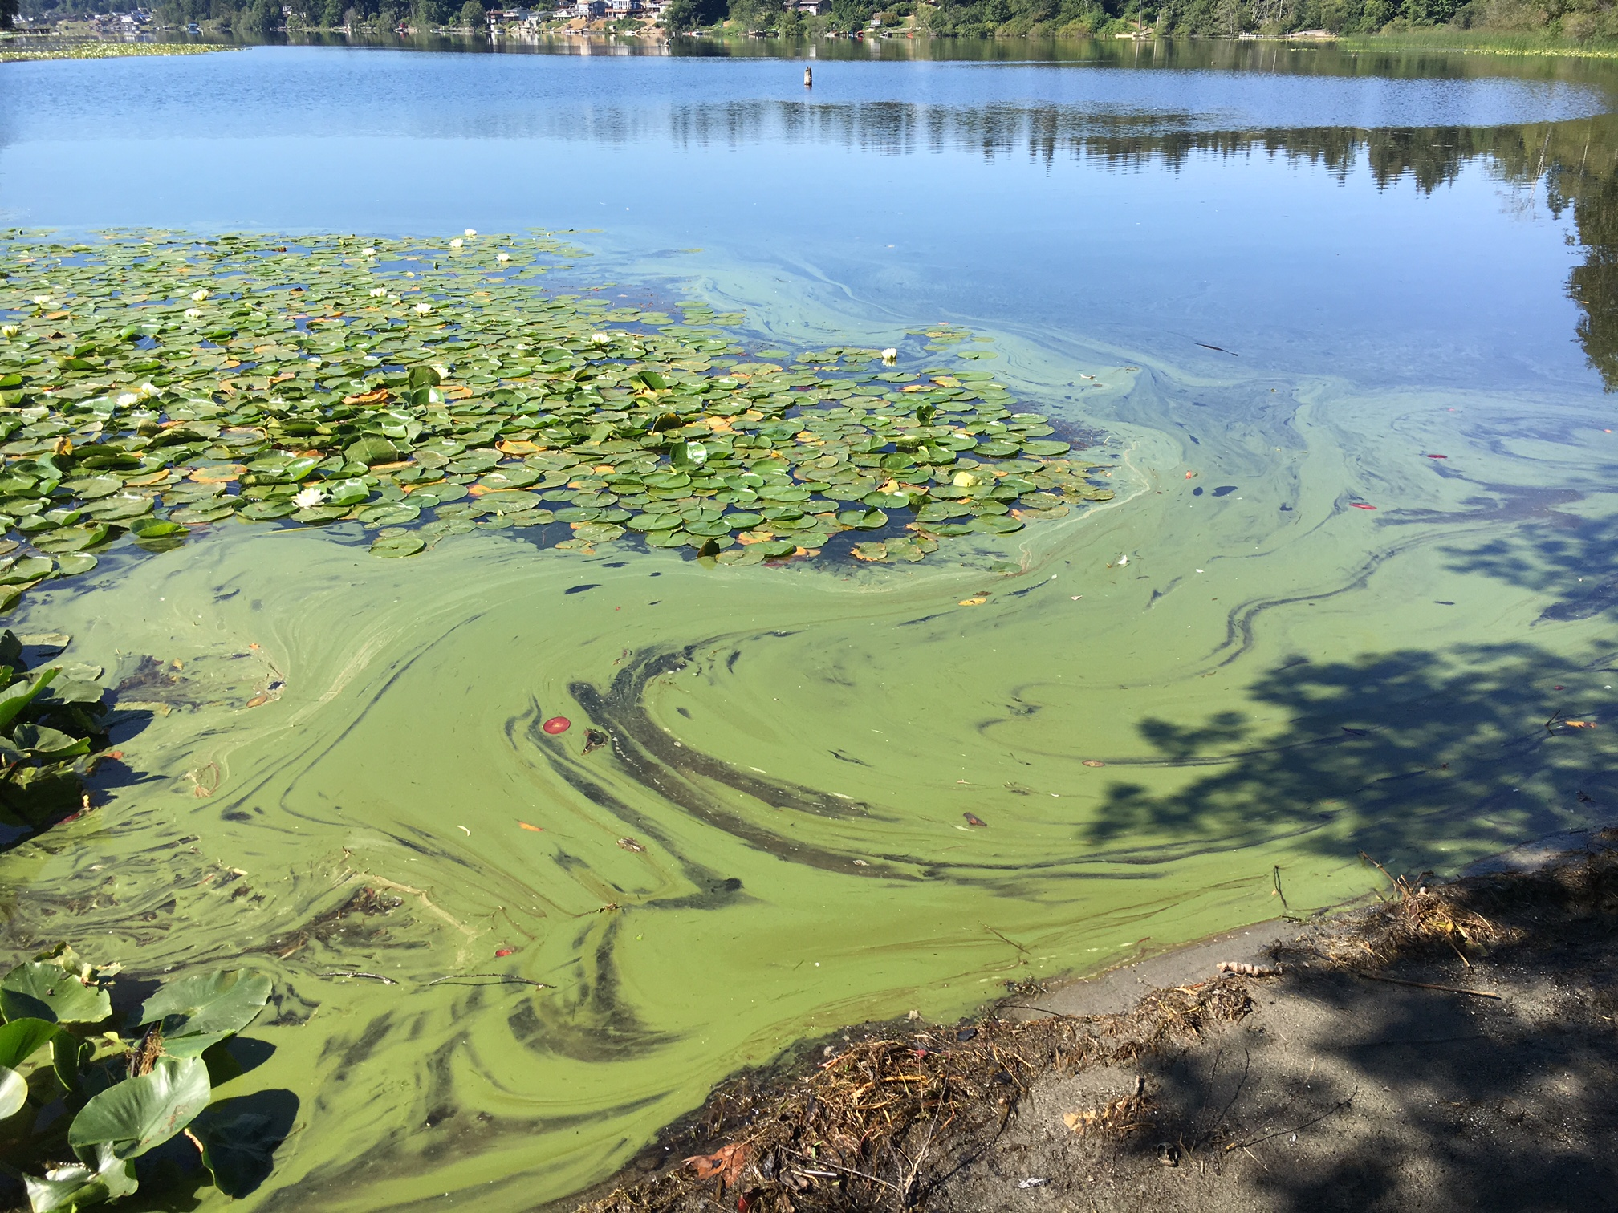
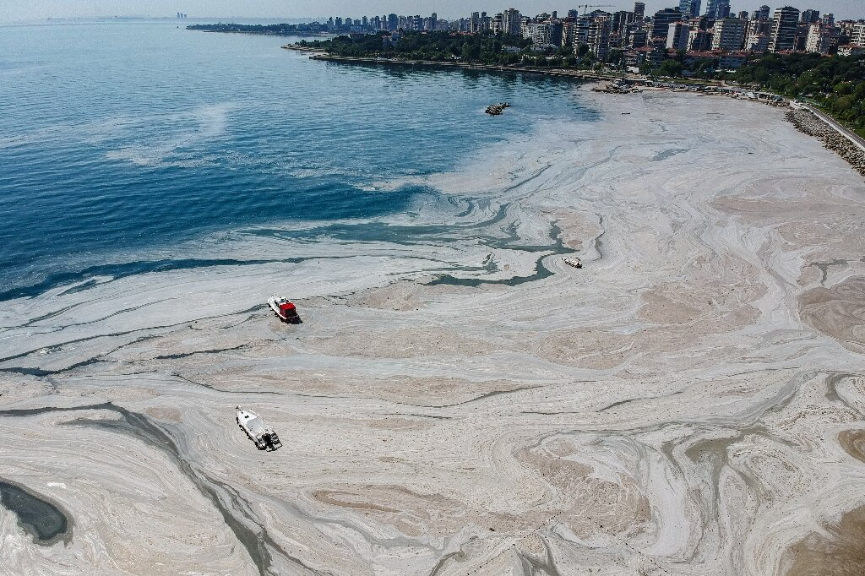
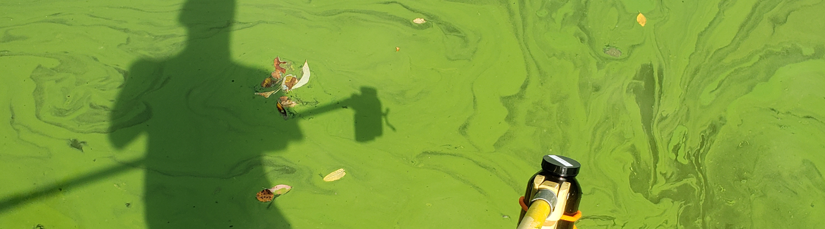
Example of HABS

Slide 8
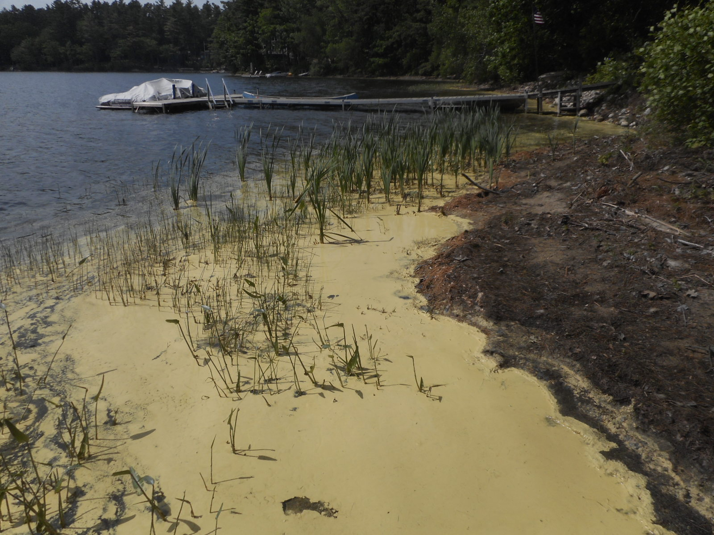
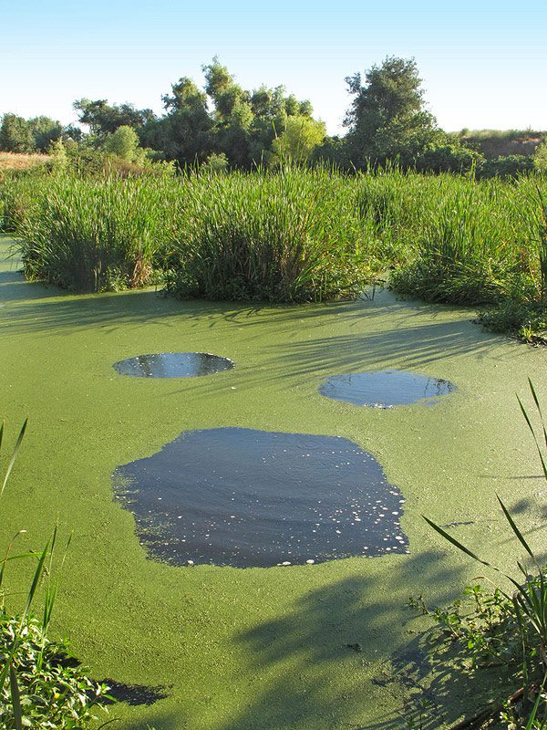
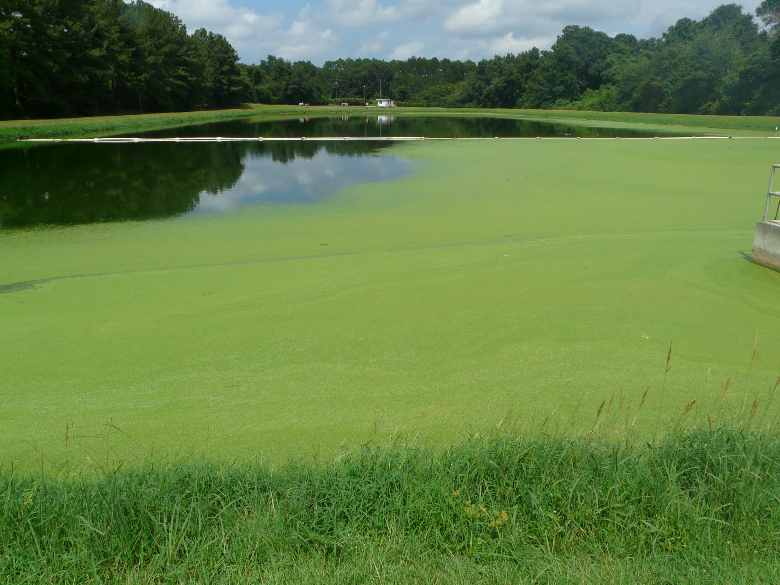

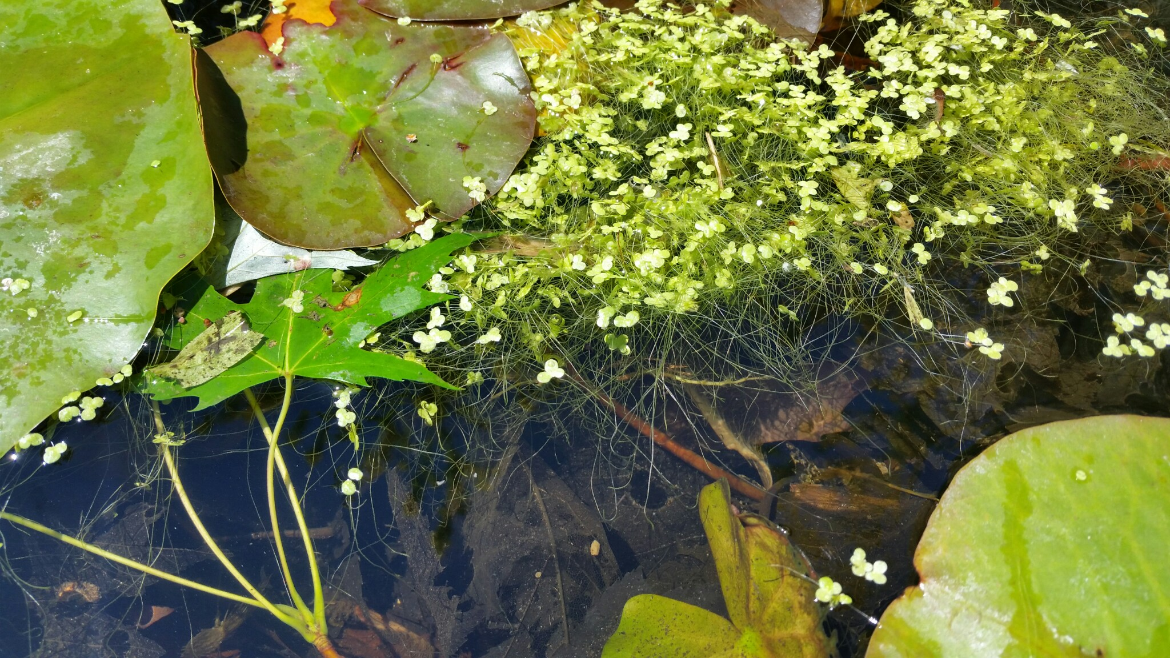
Example of NOT HABS

Slide 9
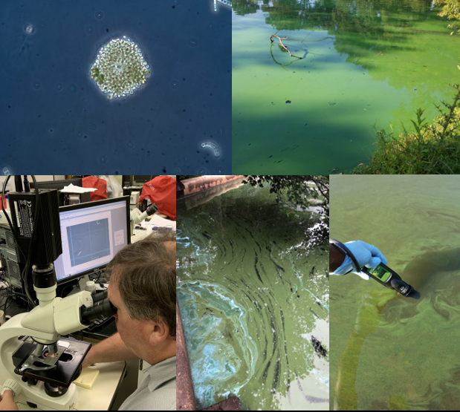
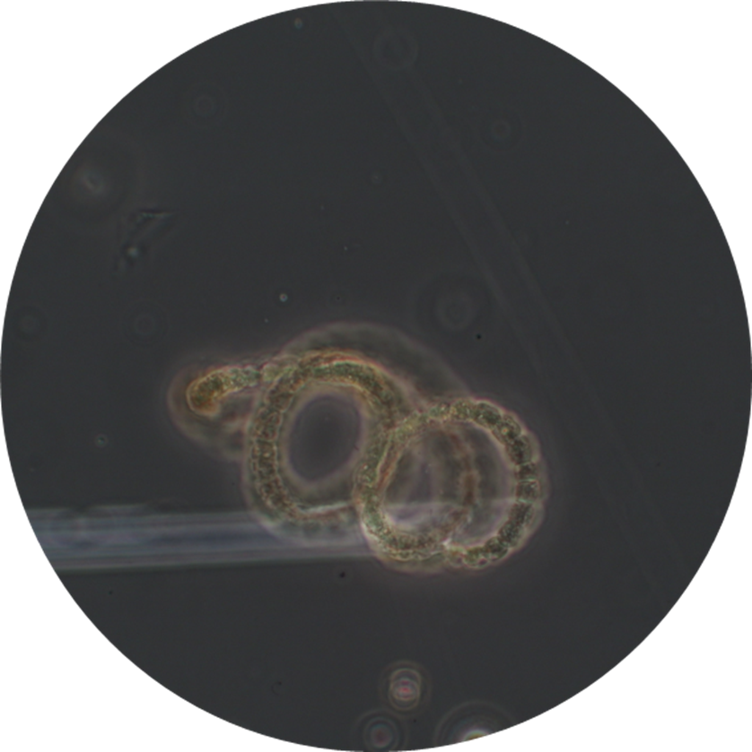

Enumeration and Identification
Enumeration and identification
Only looking at cyanos – note other species of significance
Using Hyetometer
Calculating counts (cells/ml)

Slide 10
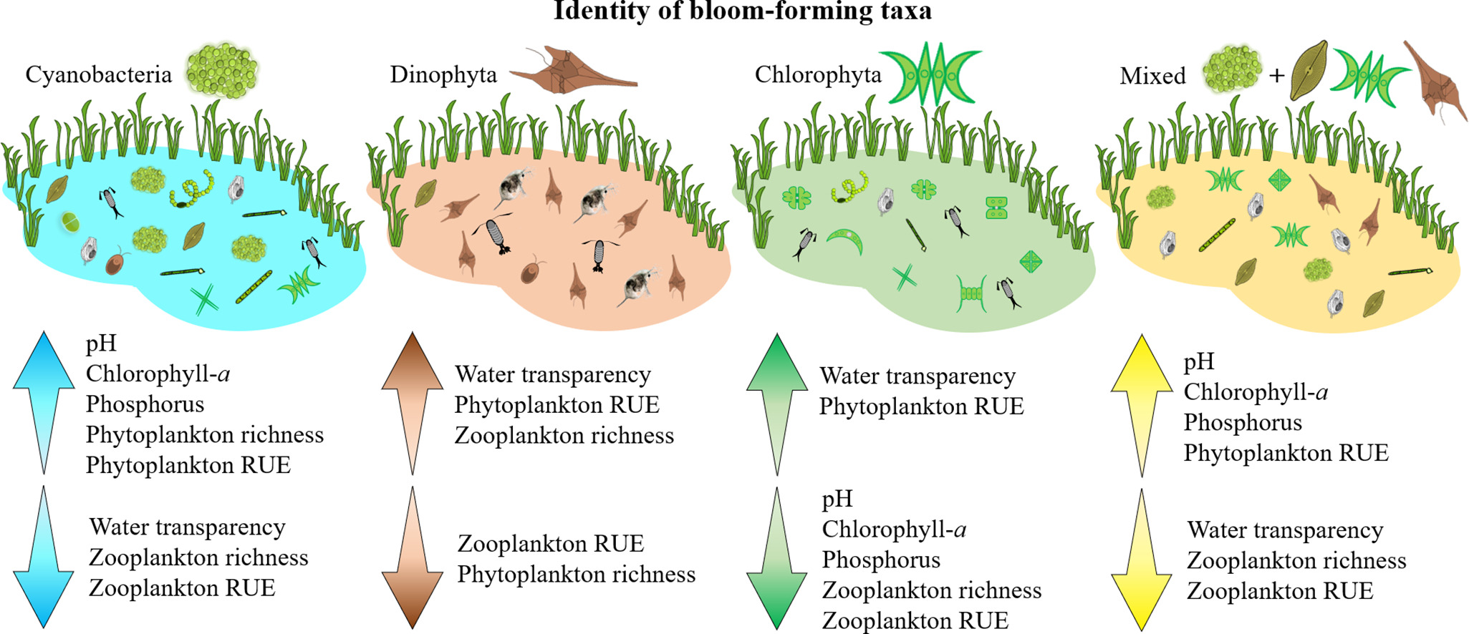
Enumeration and Identification
Image Source: https://www.sciencedirect.com/science/article/abs/pii/S0048969720371369
Resource Use Efficiency (RUE)

Slide 11
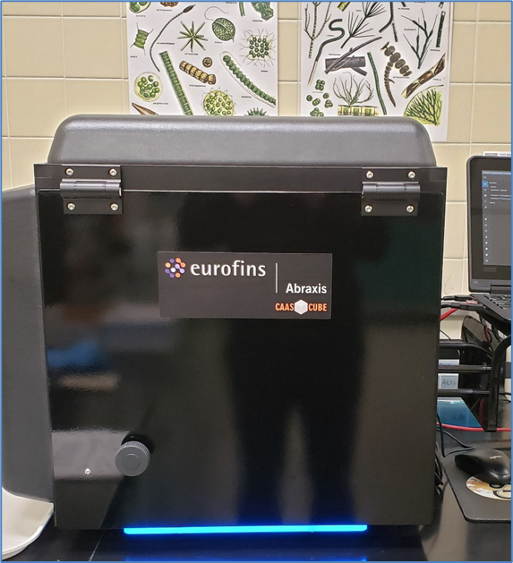
CAAS – Toxin Analysis
Enzyme-Linked Immunosorbent Assay (ELISA)
EPA-Approved ELISA Method (EPA 546) for
toxin analysis
Eurofins Abraxis brand:
  Cyanotoxin analysis of microcystins, anatoxin-a,
  cylindrospermopsin, and saxitoxin
  Microcystin is the most common toxin screened for
  +Additional toxins screened
Notes:
Additional toxins screened on samples of concern.

Slide 12
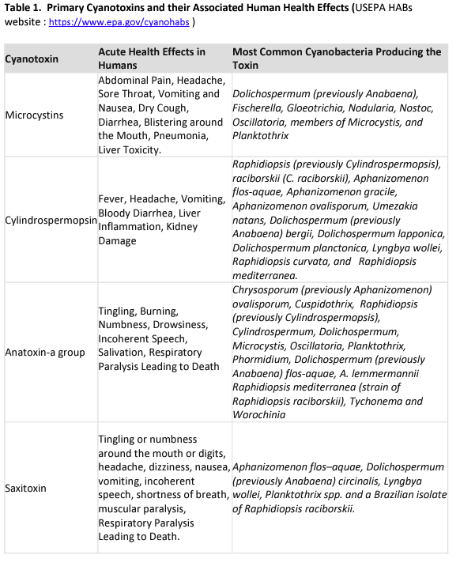

Slide 13
Guidance Values
DEP recommends the following guidance values for recreational exposure to individual cyanotoxins:
  Microcystins (as total including microcystin –LR and other detectable congeners): 2 μg/L
  Cylindrospermopsin: 5 μg/L
  Anatoxin-a: 15 μg/L
  Saxitoxin: 0.6 μg/L

Slide 14

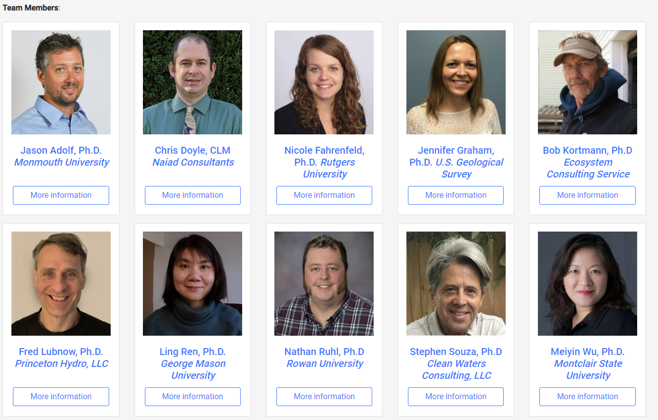
HAB Expert Team
Consultants, academia, researchers, etc.
Provide guidance to DEP on HAB prevention,
mitigation and management for NJ lakes
and other waterbodies.
Prevention and treatment of
HABs, review HAB and water
quality data, and develop
guidance documents

Slide 15
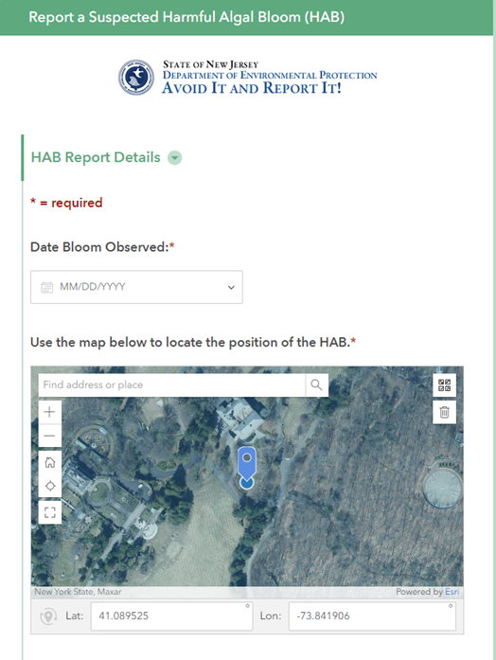
Reporting a HAB
WARN-DEP, email, volunteer monitoring
or HAB app
Partners must wear gloves provided by BFBM
when collecting measurements
Reports of suspected HABs via the public
survey123 reporting app
Submit phycocyanin and
temperature measurements through the app
  Entered in comment section as the first items
Investigation through DWMS/BFBM staff
  HAB Coordinator:
    Monitoring will be prioritized based on risk to public health

Slide 16



All Divisions Working Together
Partners include: local health departments, state and local park authorities, DEP’s Division of Fish and Wildlife personnel for Wildlife Management Areas, DEP’s Water Compliance and Enforcement program, DSR, academia, Water Suppliers with surface water supplies, USGS, Rutgers Cooperative Extension, lake associations, watershed associations, DEP Watershed Ambassadors, and volunteers.

Slide 17
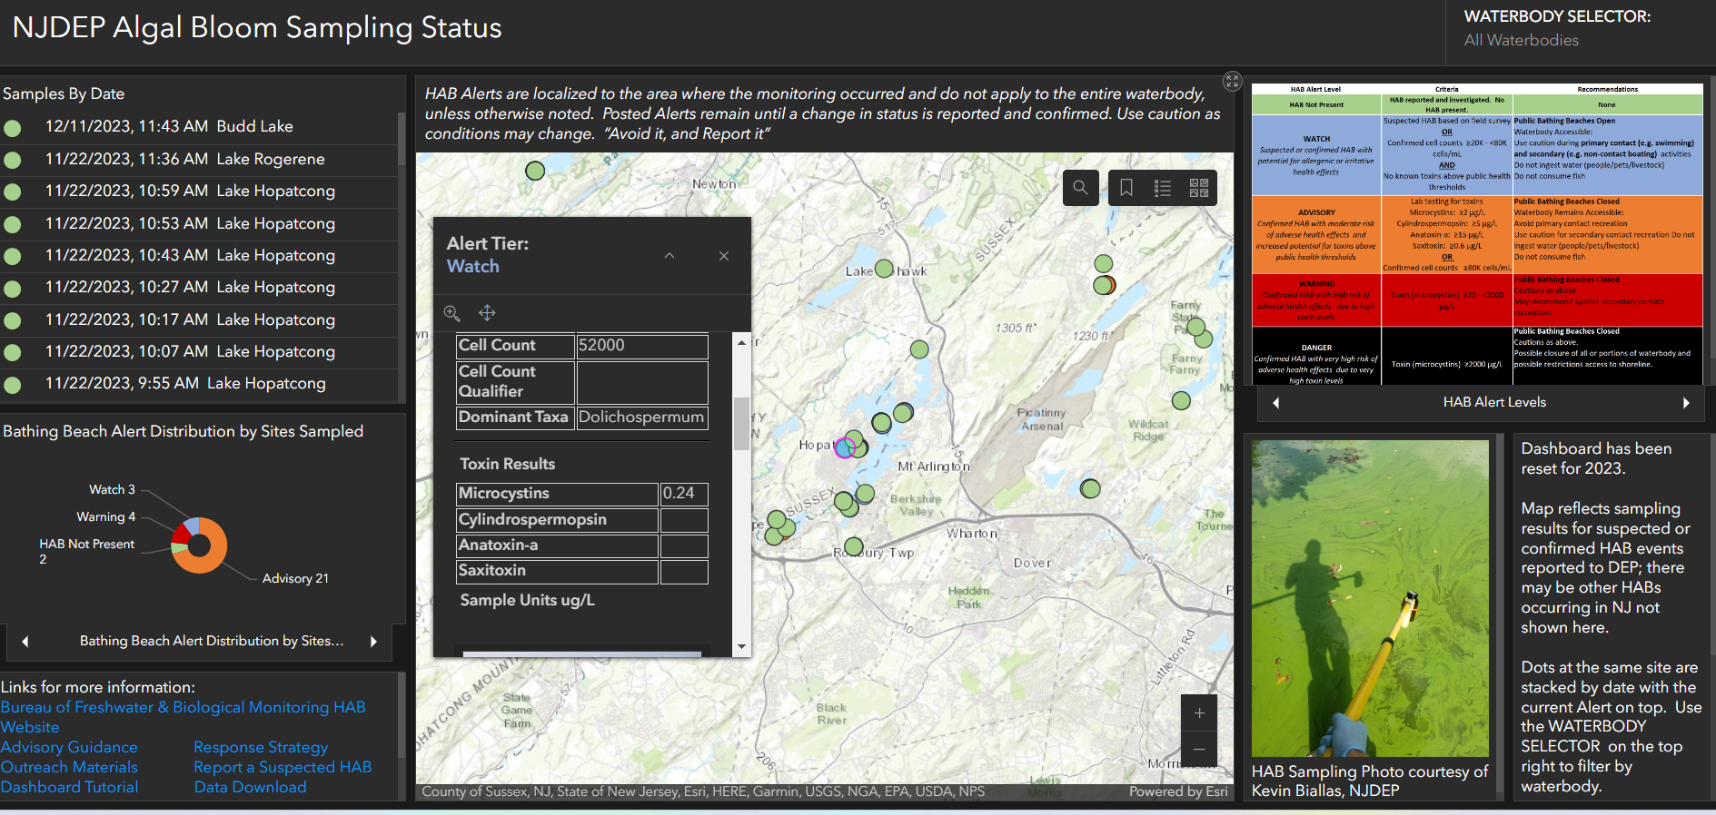
HAB Dashboard

Slide 18

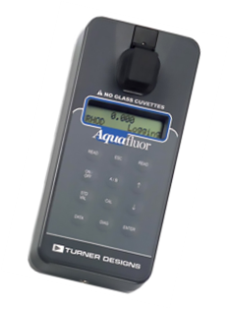
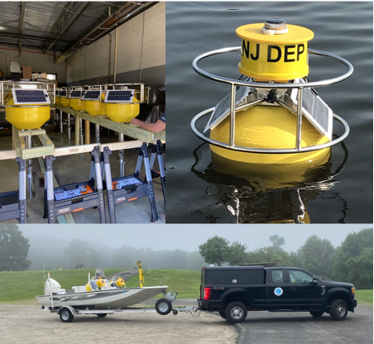
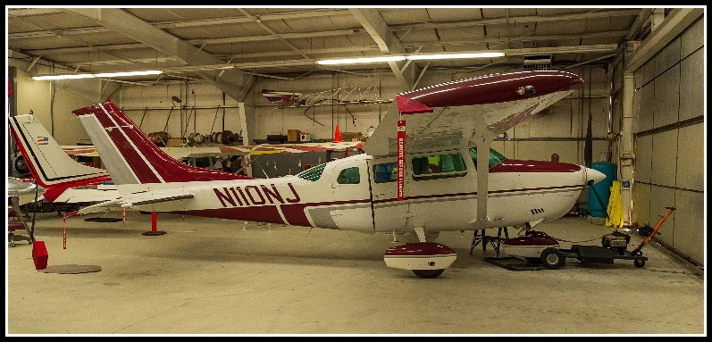


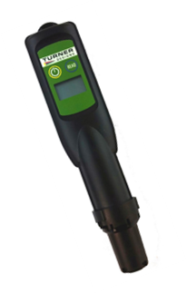
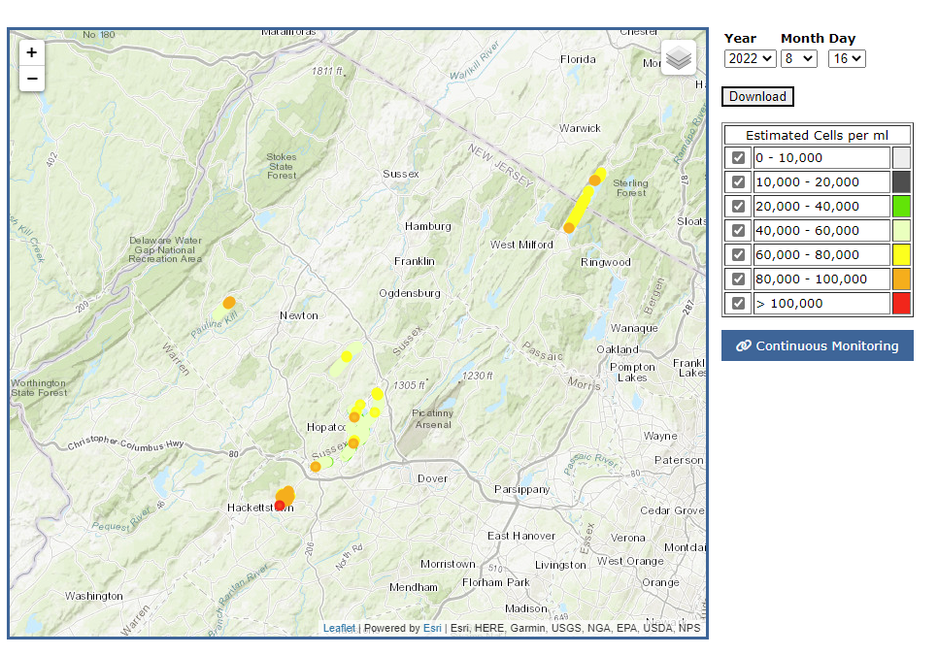
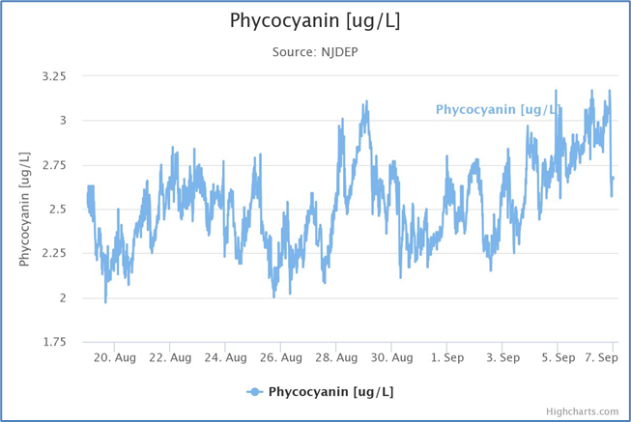
Tools in the toolbox
Notes:
Screening Tools:
-Cyanobacteria Presence and Field Measurements
-Visual Assessment
-Remote Sensing – Satellite Imagery, Aircraft Flight Reconnaissance and Unmanned Aerial Vehicles (UAVs)
-Satellite imagery. Satellite imagery, such as the USEPA’s Cyanobacteria Assessment Network Application (CyAN app)
-Continuous Data Monitoring Program
-Toxin Presence
It should be cautioned that the absence of microcystins does not indicate the absence of all toxins, such as cylindrospermopsin and anatoxin-a. If any other screening indicates the presence of a potential HAB, then laboratory analysis may be performed for other toxins.
DEP will make every effort to respond to reported suspected HABs as soon as possible. In the event that resources are limited, the response actions will be prioritized based on potential risk to public health. 1. Drinking water sources. 2. Bathing beaches (PRBs). 3. Recreational waters without bathing beaches. 4. Waterbodies with a protective alert already in place. 5. Waterbodies not covered in the above.

Slide 19
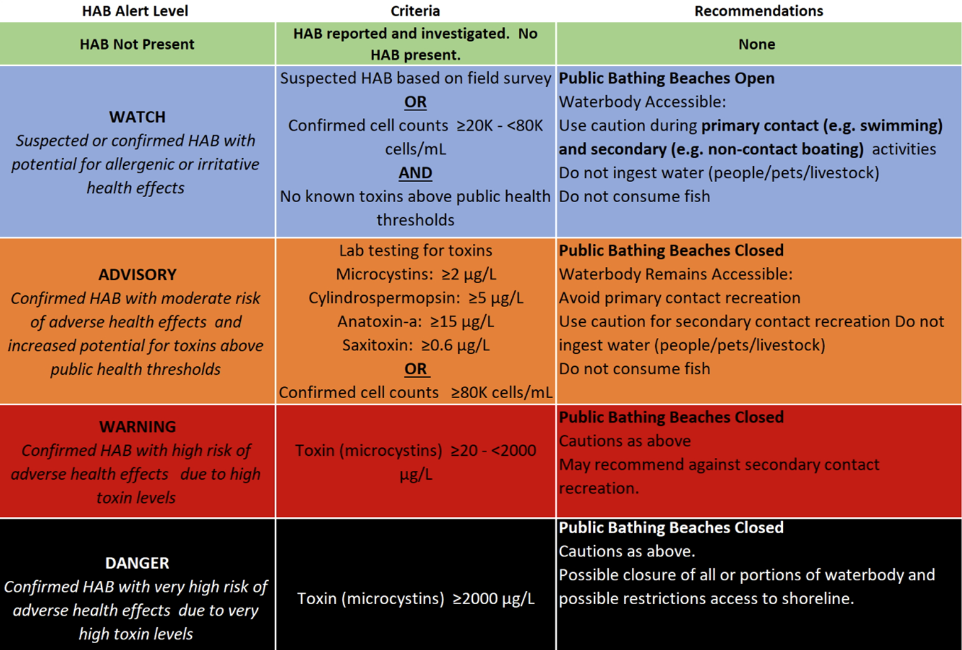
Tiered Alert System

Slide 20
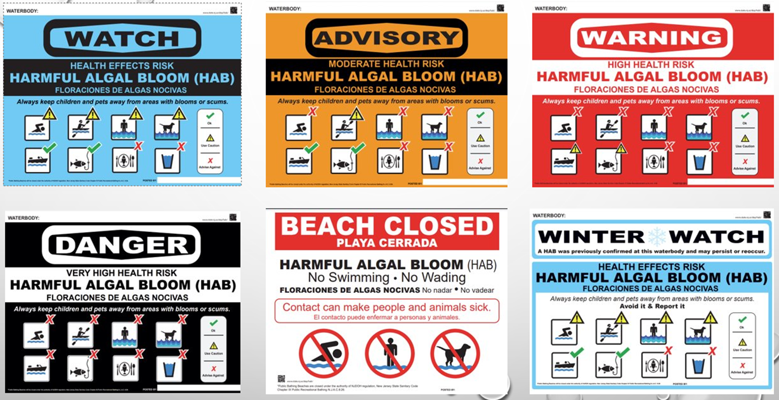

Slide 21

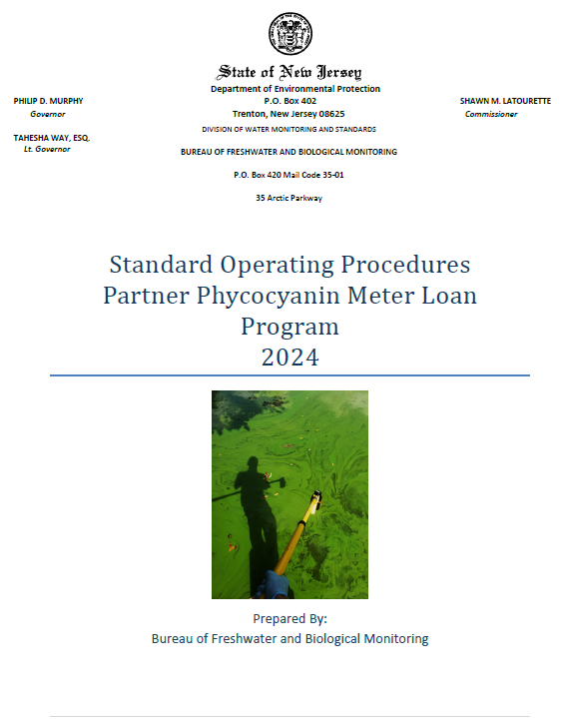
Phycocyanin Meter Loan Program
Partners can submit their data to the HAB app
Given an SOP guide to provide guidance and support during the use of the meter.
Helps support our HAB response
https://www.nj.gov/dep/hab/outreach-material.html#vids
For meter requests contact: njcyanohabs@dep.nj.gov

Slide 22
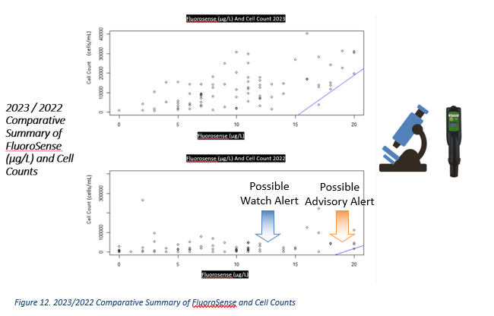

Slide 23
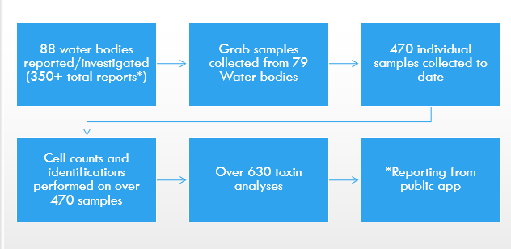
2023 HAB Annual Summary
2024 HAB Strategy updates: in progress
Final report: currently in review

Slide 24
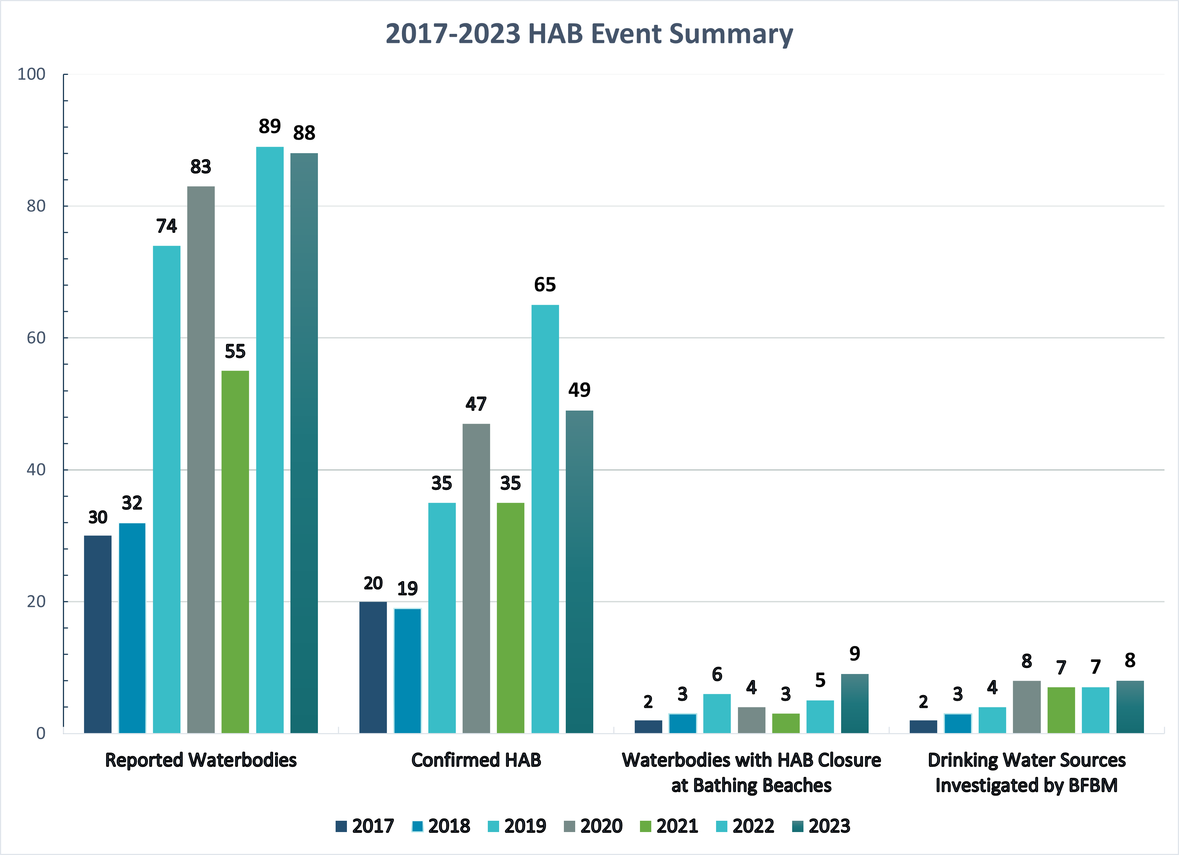

Slide 25
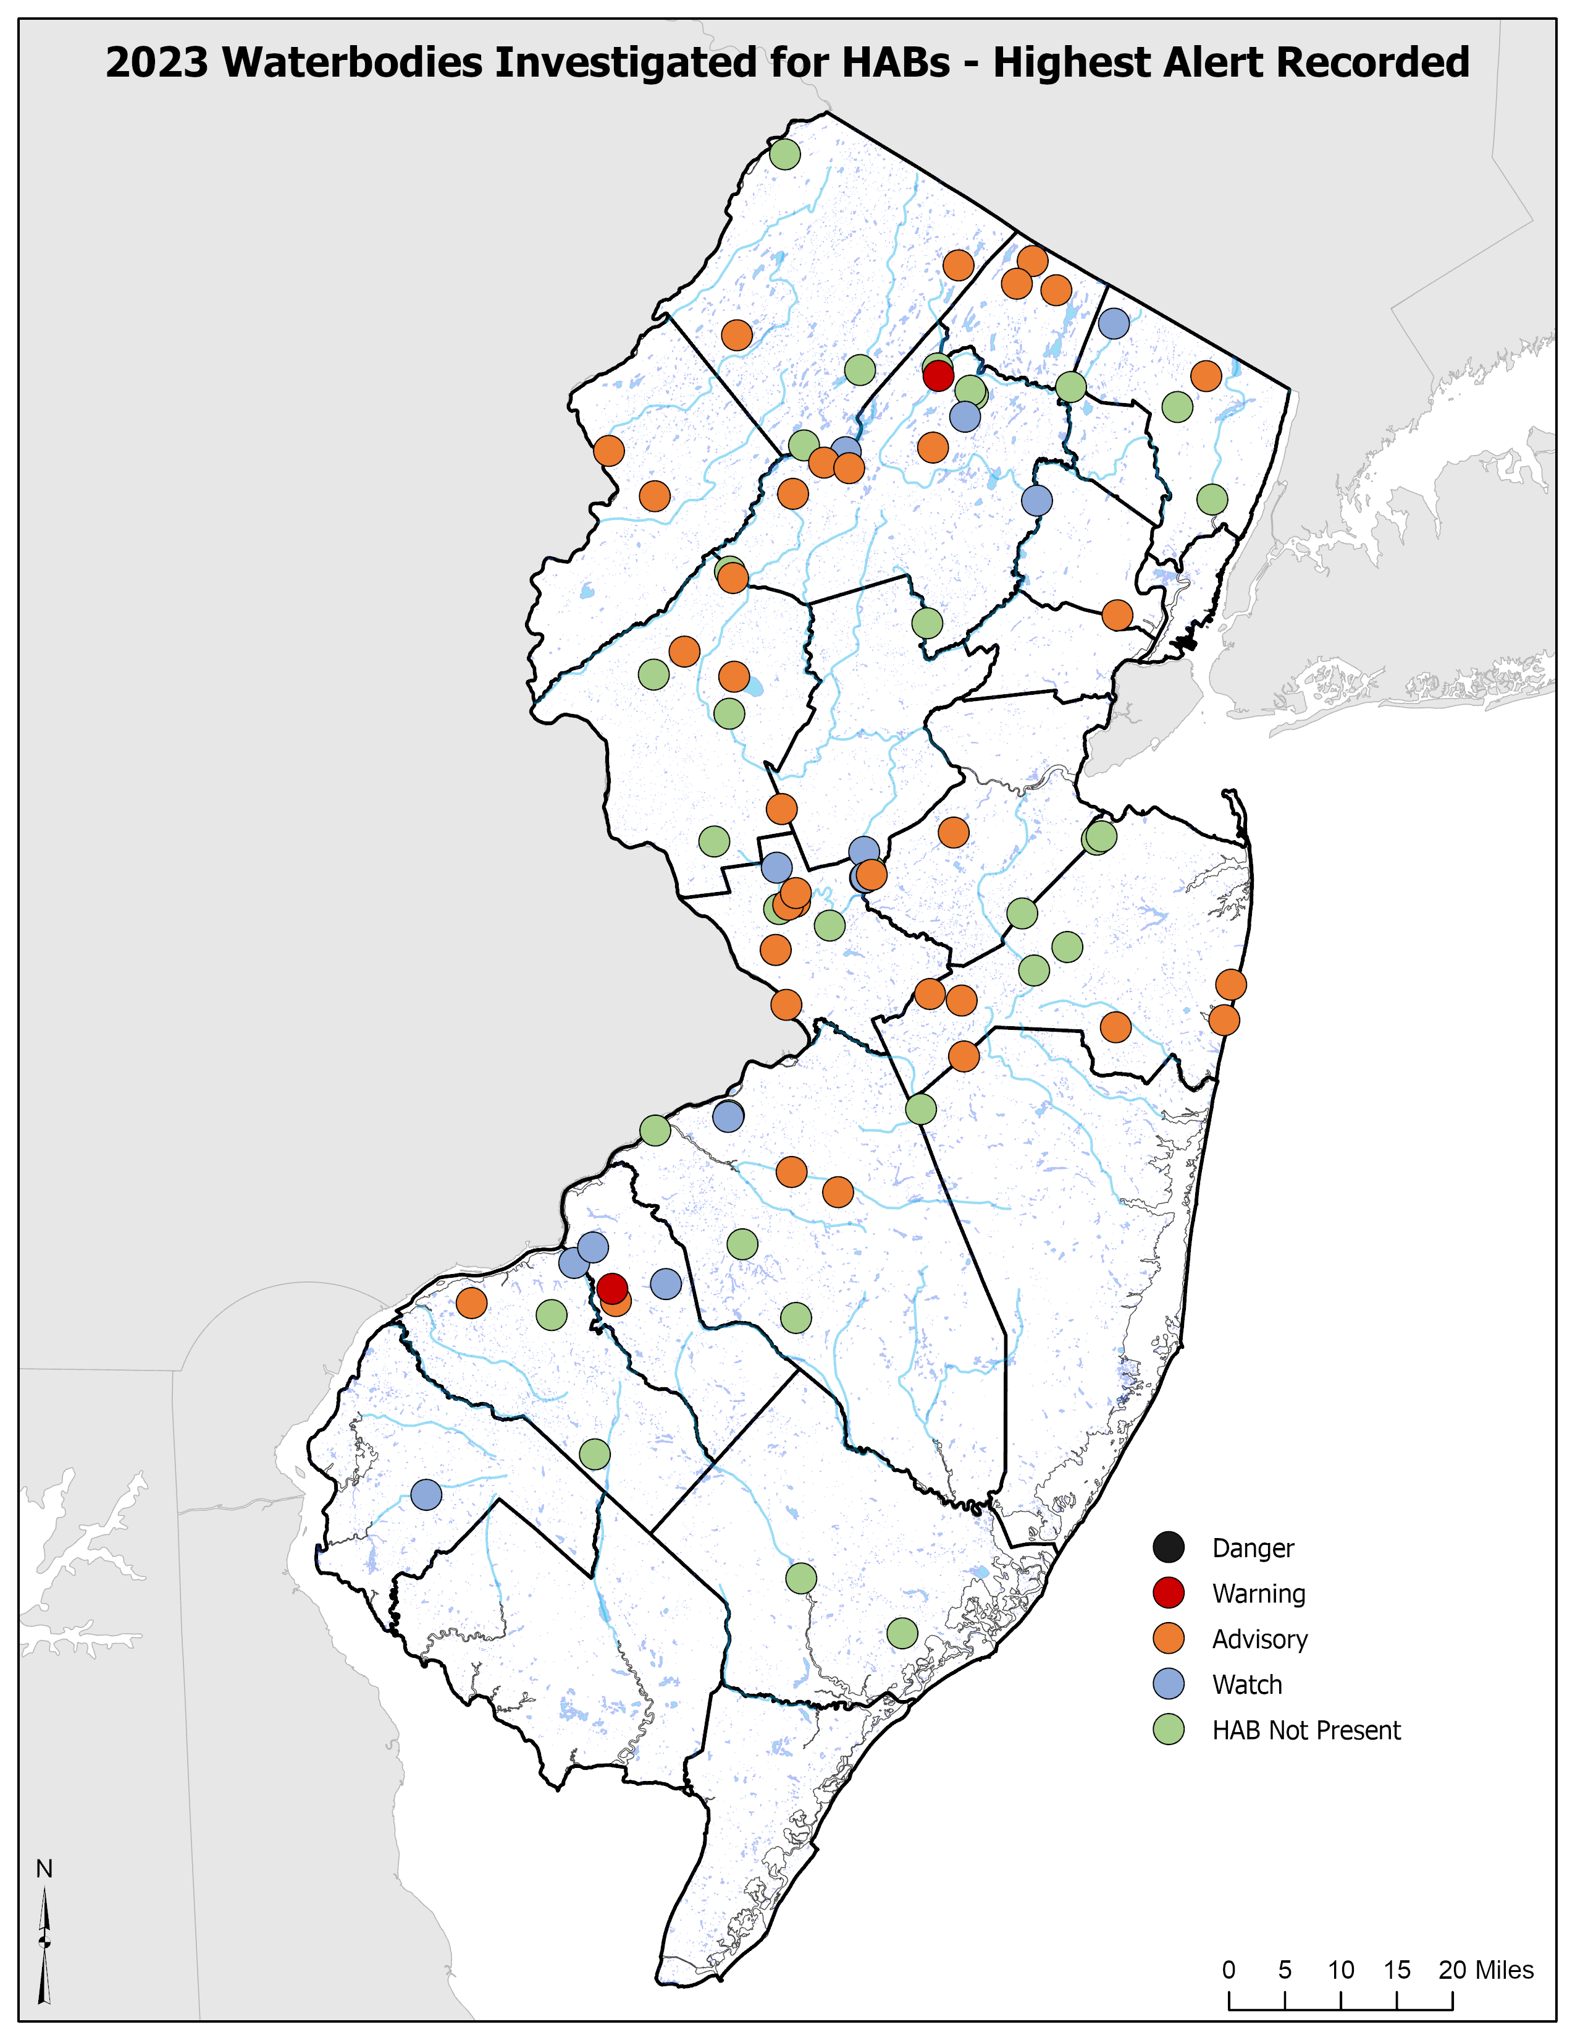

Slide 26
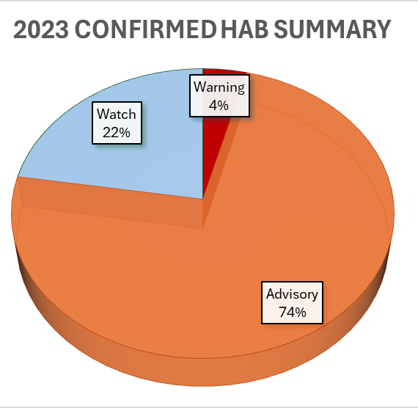
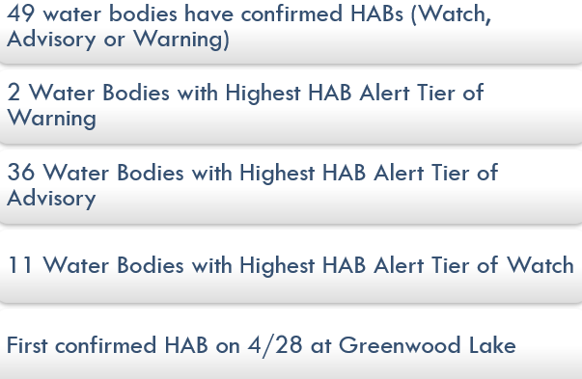
2023 HAB Season

Slide 27
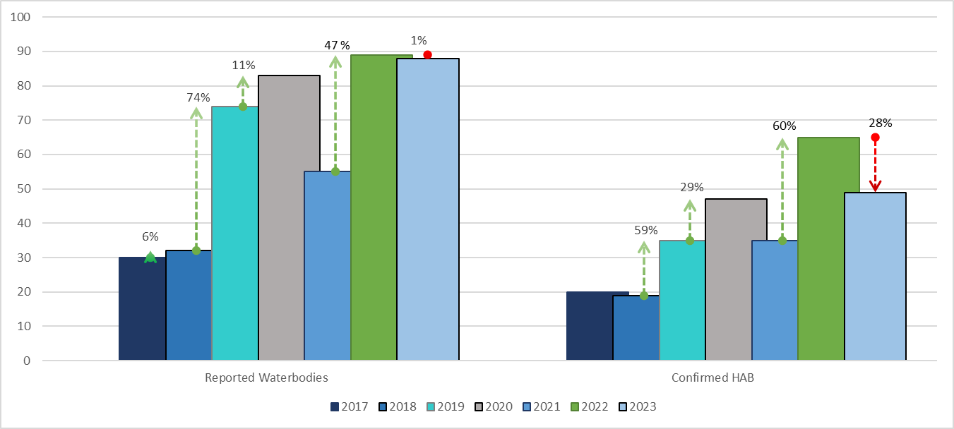
HAB % occurrence
(2017 – 2023)

Slide 28
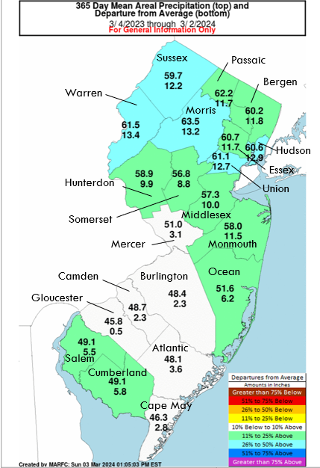
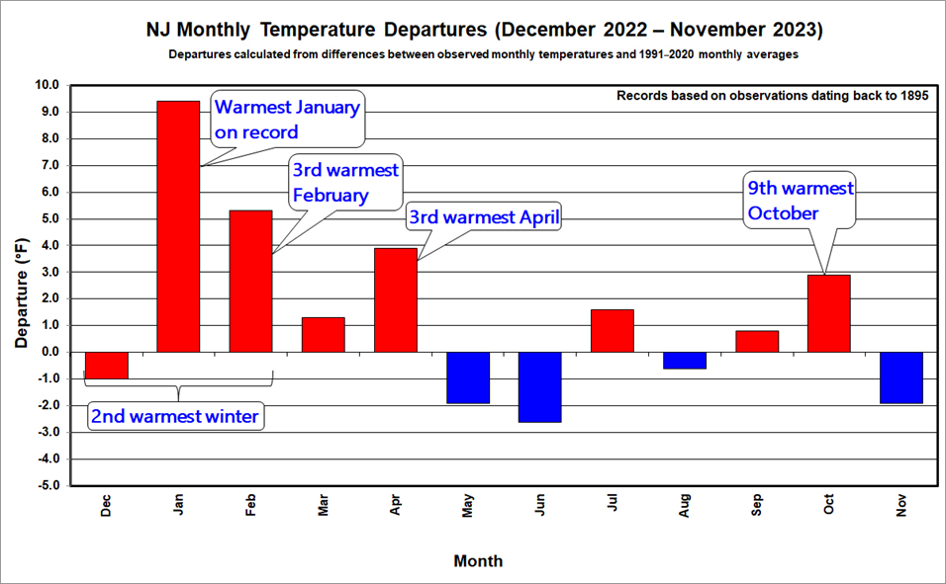

Slide 29
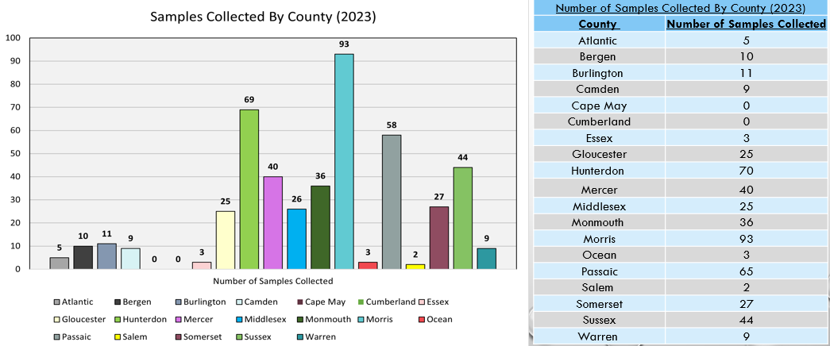
Samples by county (2023)

Slide 30
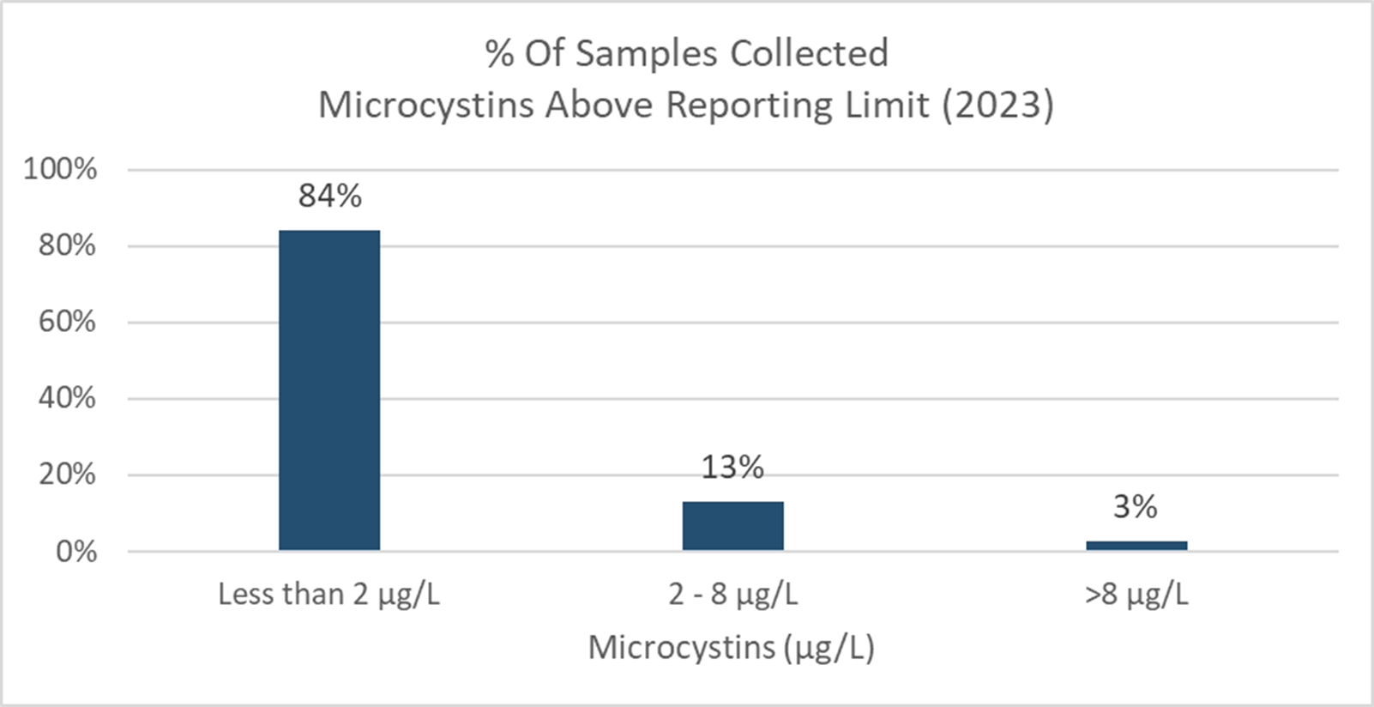
Notes:
MCT Threshold
#Samples
Less than 2 μg/L
396
2 - 8 μg/L
61
>8 μg/L
13

Slide 31
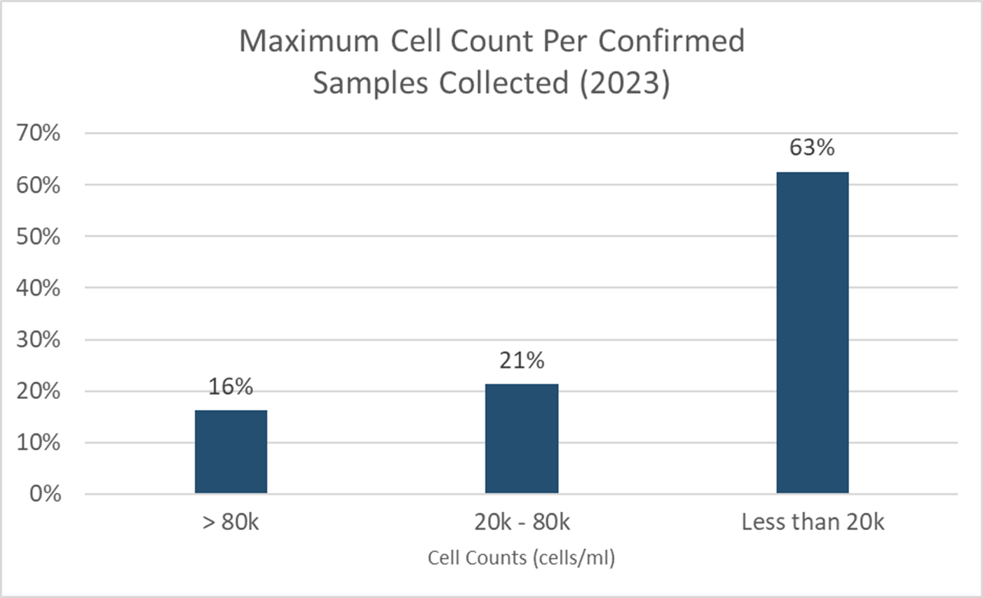
Notes:
Cell Count Threshold
Waterbodies with Confirmed Samples
Less than 20k
294
20k - 80k
100
> 80k
76

Slide 32
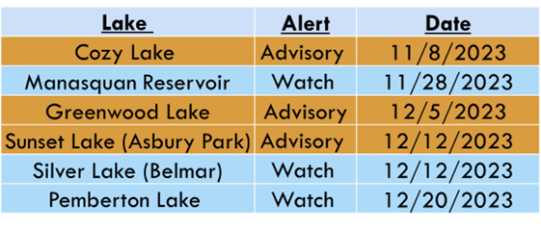
Winter HABs

Slide 33

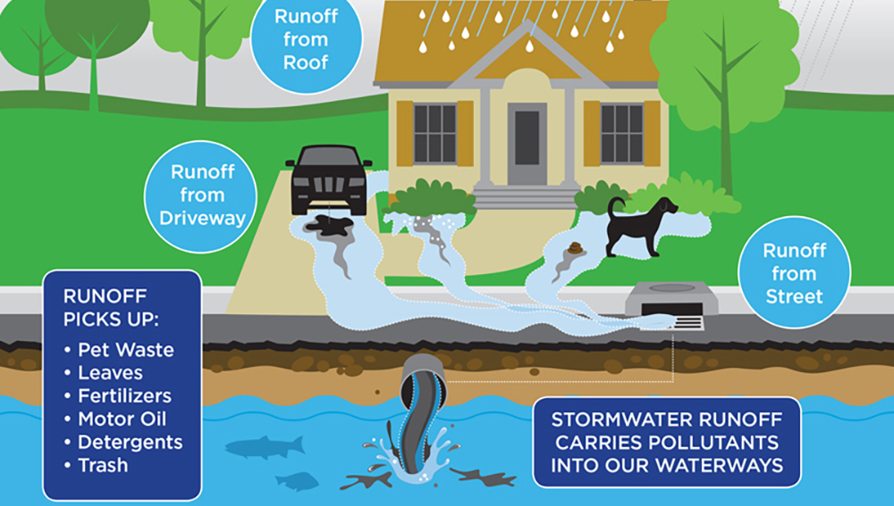

Lakeside Homeowners:
HAB Prevention
Ways to Reduce your chances of your lake
having a hab:
  Reduce Nutrient inputs
  Proper Septic system maintenance
  Manage stormwater runoff
  Shoreline stabilization
  Reduce impervious surfaces
  Responsible boat and pet waste management
  Participate in lake protection programs

Slide 34

Thank you!
Contact Information:
Emily Mayer, M.S.
Emily.Mayer@dep.nj.gov

