Slide 1




New Jersey
Coalition of Lake Association
Introduction, Overview, and Capabilities
Driven by Performance. Powered by People.
Copyright 2023 Paragon ISG Company. All rights reserved.
Increased headcount from 72 to 92

Slide 2


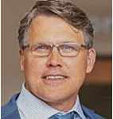
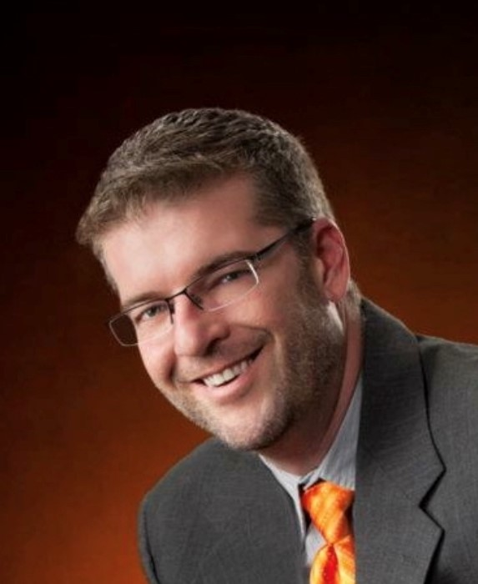
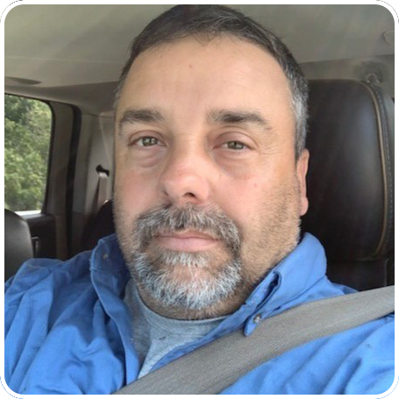
Environmental Leadership
Todd Watkins
Vice President Environmental Services
B.S. in Mechanical Engineering, Mississippi State University
14-year tenure in pulp & paper industry, engineering and operations management roles
15-year tenure in environmental, recycling and waste services
Experience in recycling technologies, landfills, and regulatory permitting
Dan Mount
Manager of Environmental Sales
Experienced Technical Sales Engineer with proven sales strategy development
25+ experience in Environmental, Bio-Solids Management, Government, Parks and Recreation, Energy Services and City Administration
Strong customer relationship cultivation and service skills
BS in Civil Engineering from The Ohio State University
US Navy Veteran
Ed Moyer
Manager of Environmental Operations
Experienced Manager in the environmental industry
Skilled in Sales, Team Building, Onshore Operations, and Supervisory Skills
Strong operations professional in pond management, dredging, solids control and invasive weed mitigation
Agricultural Engineering focus, Mechanics and Science
Graduated from Ohio State University Agricultural Technical Institute
Copyright 2023 Paragon ISG Company. All rights reserved.
Increased headcount from 72 to 92

Slide 3




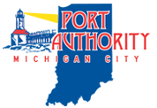
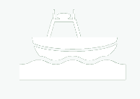







OPERATIONAL FOOTPRINT
OWNERSHIP
Houston HQ
Audited by PwC
100+ employees distributed across multiple locations in the country
Majority ownership held by Palladium Equity Partners, a New York City-based private equity firm (founded in 1997). Palladium has invested over $2.8 billion of capital in 36 platform investments and 140 add-on acquisitions
5 warehouse/shop locations with ~335,000 SF in PA, NY, OH and Texas
Our team is made of the industry’s most experienced experts in environmental services drilling fluids and solids control.
WHAT WE DO
CUSTOMER BASE
BATHYMETRICS
WASTE & WATER TREATMENT
REMEDIATION
DREDGING
ON-SITE DEWATERING
Copyright 2023 Paragon ISG C-ompany. All rights reserved.
Anadir los logos de ECT2, City of New Philadelphia Ohio, Gulf Breeze Florida

Slide 4
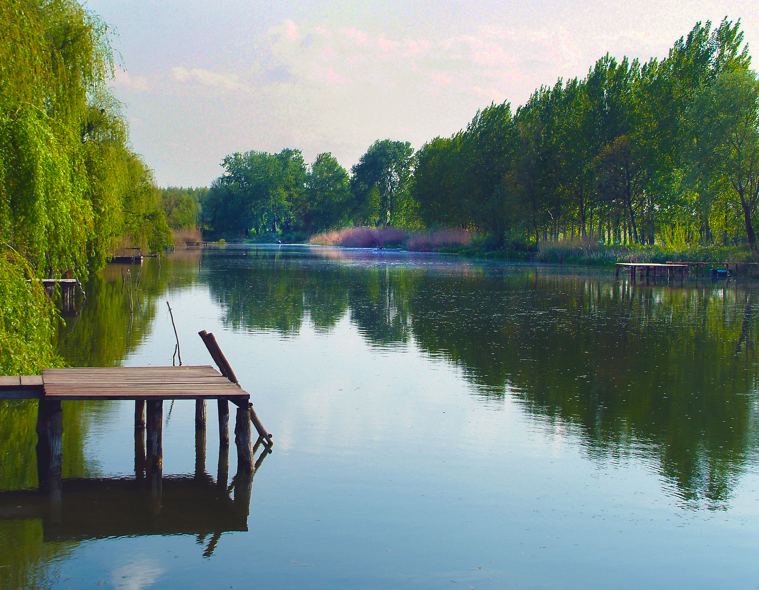
We help our customers deliver efficient
and cost productive environmental and
solids management operations.
Our services include fluids management, dewatering,
desludging, and water remediation for the environmental
and energy industries across the United States.
Copyright 2023 Paragon ISG C-ompany. All rights reserved.

Slide 5
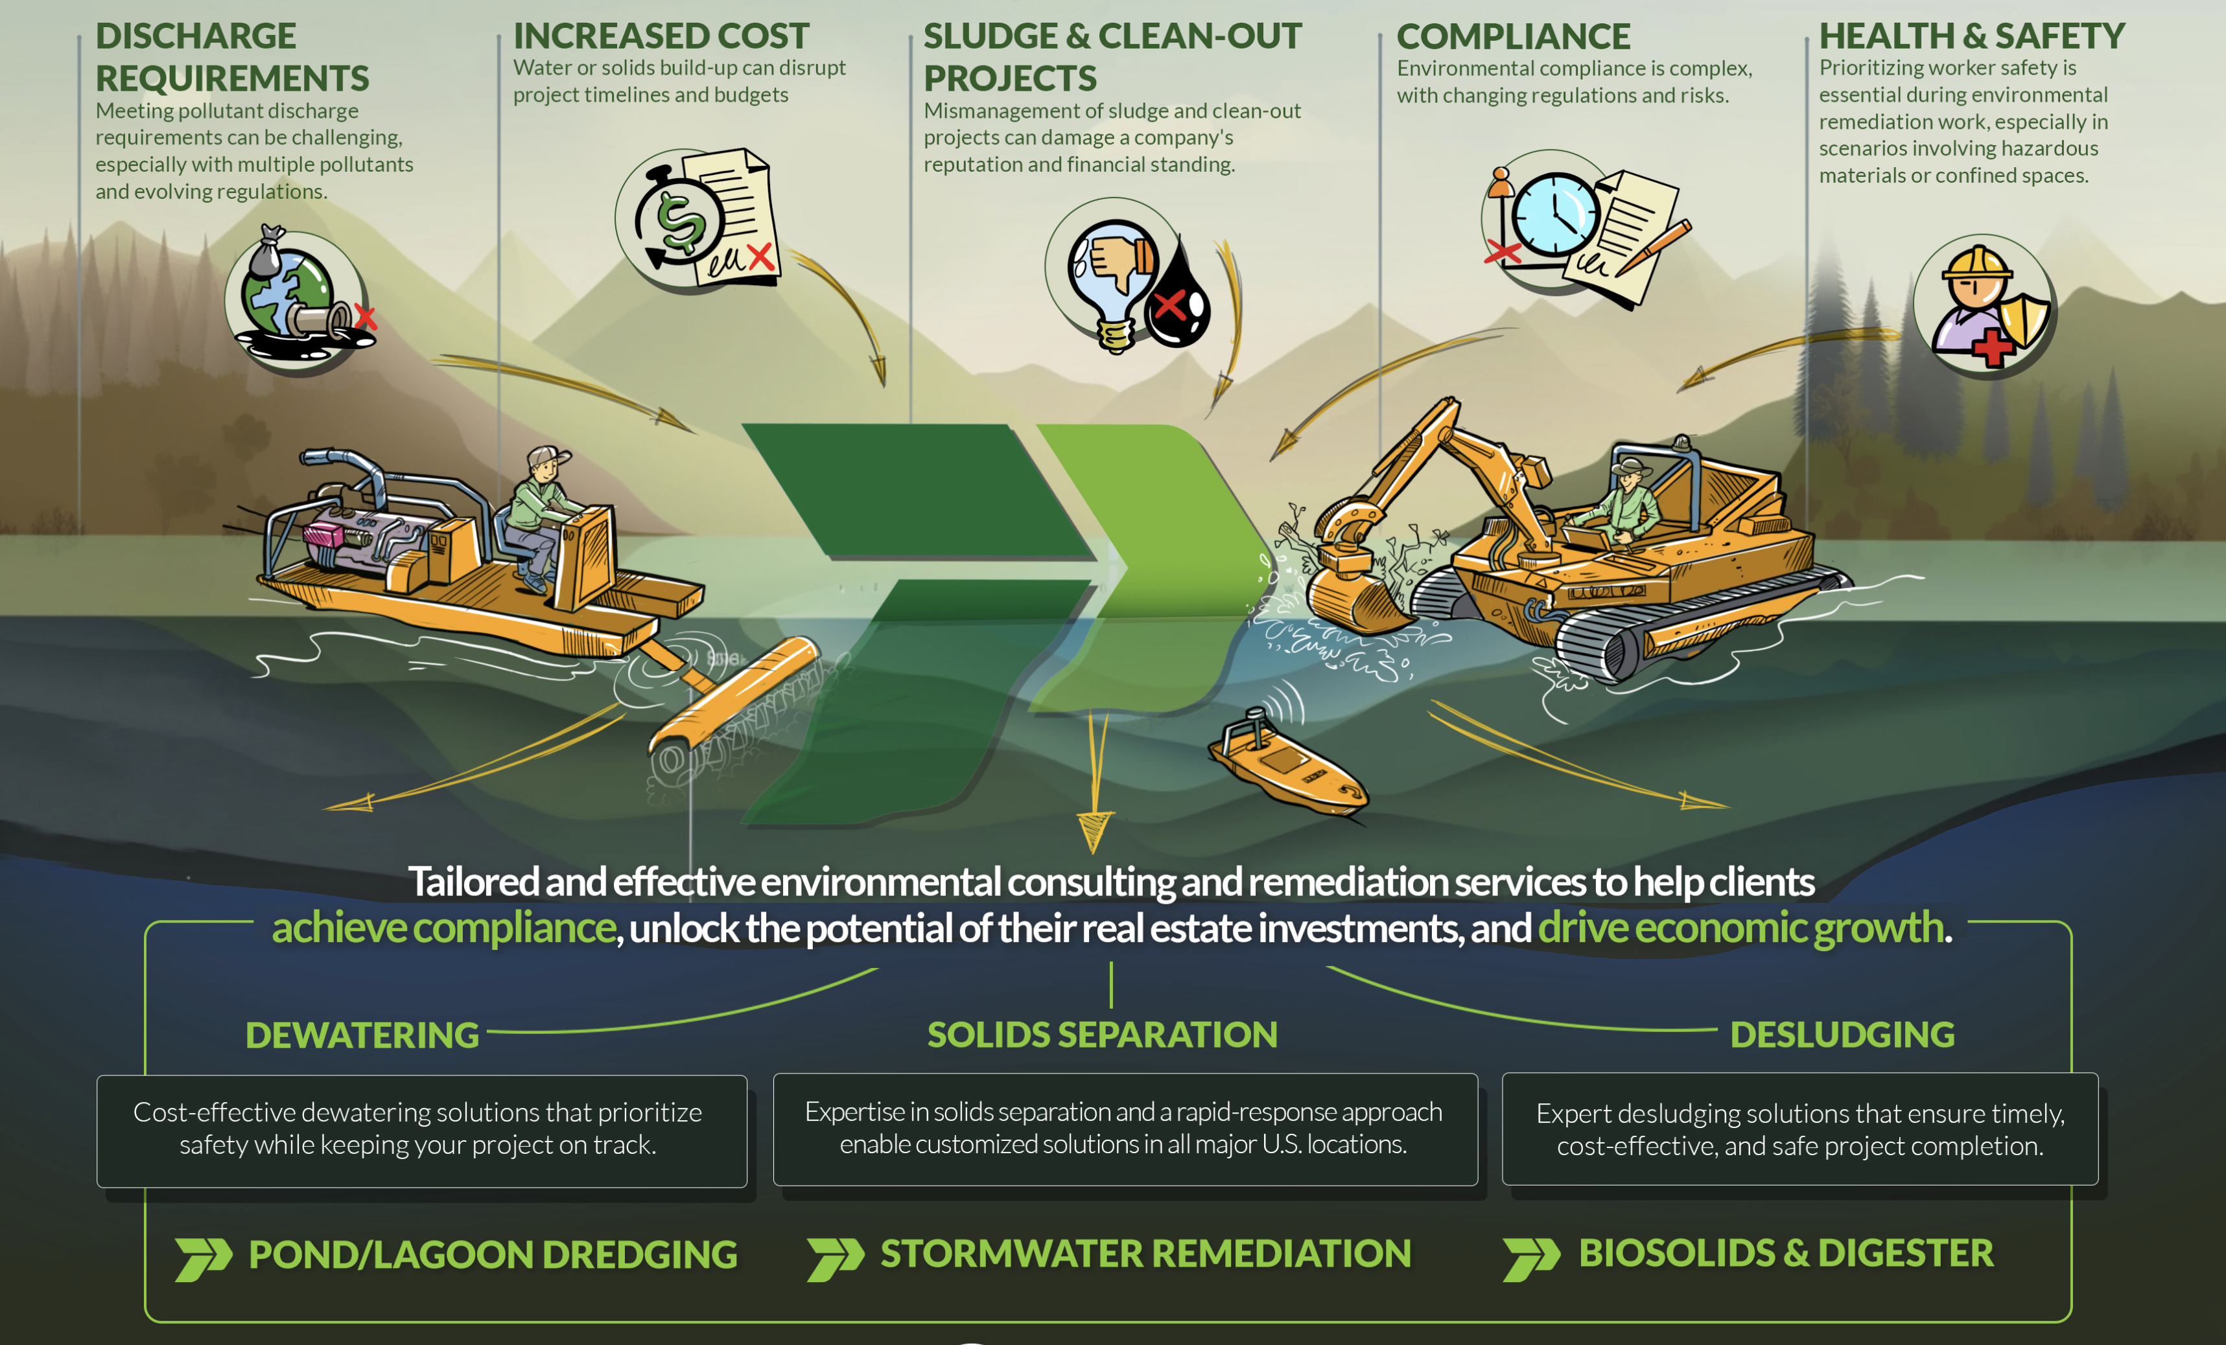
ENVIRONMENTAL
SERVICES
Tailored and effective environmental consulting and remediation services to help clients achieve compliance, unlock the potential of their assets and drive economic growth.
Copyright 2023 Paragon ISG Company. All rights reserved.
Increased headcount from 72 to 92

Slide 6
BATHYMETRICS
WHAT’S DOWN THERE?
Copyright 2023 Paragon ISG C-ompany. All rights reserved.

Slide 7
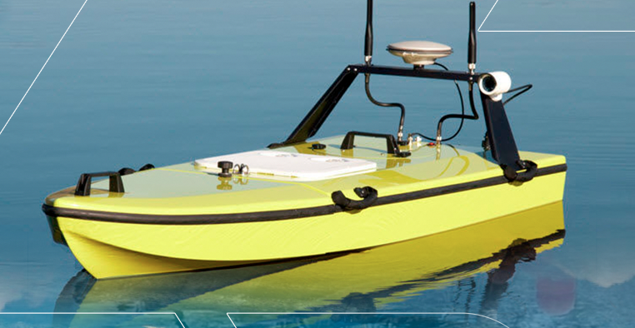
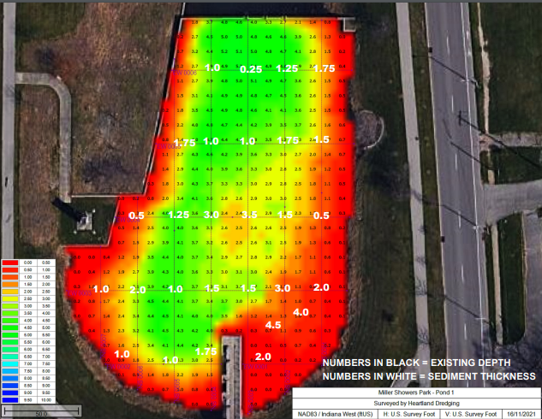
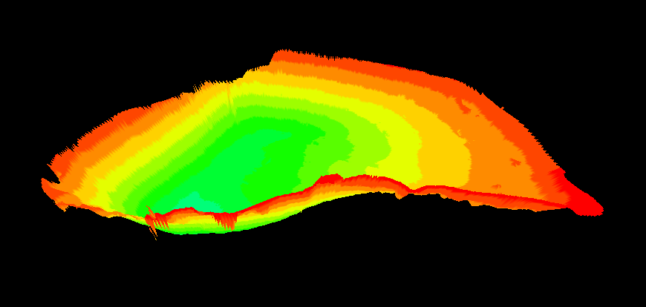
EQUIPMENT TECH SHEETS
Remotely Operated Surveying Boat
Dimensions (Overall):
Length: 6’
Width: 3’
Height: 2’
Dimensions (Hull):
Length: 6’
Width: 3’
Height: 2’
Controls
Remotely Operated via GPS
Battery:
12V, 88 Ah Electrical Control System
Dolphin
· Mine Tailings Ponds
· Wastewater Treatment Digesters
· Chemical Plants · Pulp Mills
· Rock–Stone-Sand Quarries
· Farm Slurry · Ash Ponds
Copyright 2023 Paragon ISG Company. All rights reserved.
Increased headcount from 72 to 92

Slide 8
WEED HARVESTING
Copyright 2023 Paragon ISG C-ompany. All rights reserved.

Slide 9
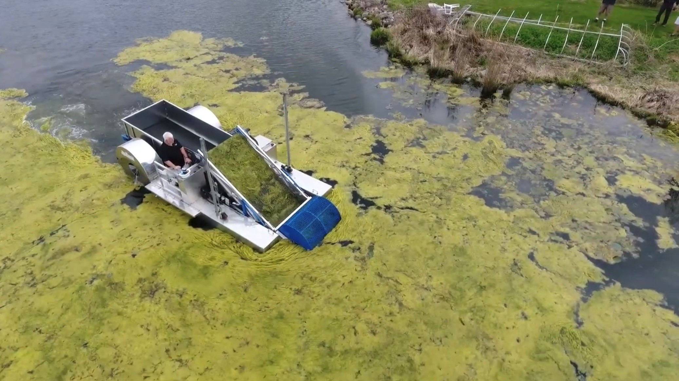
Aquatic Weed Harvesting
Surface Harvesting
“Brontosaurus”
The perfect piece of equipment for aquatic weed removal.
Paragon’s weed harvester known as Brontosaurus uses a cutter head or wheel attachment as seen in the picture to the right. The two-wheel attachment pulls in and pinches weeds attached to the bottom of the lake or pond. Then, pinches the stem, pullng it with the roots to remove them.
Ponds
Lakes
HOA’s
Golf Courses
Copyright 2023 Paragon ISG Company. All rights reserved.
Increased headcount from 72 to 92

Slide 10
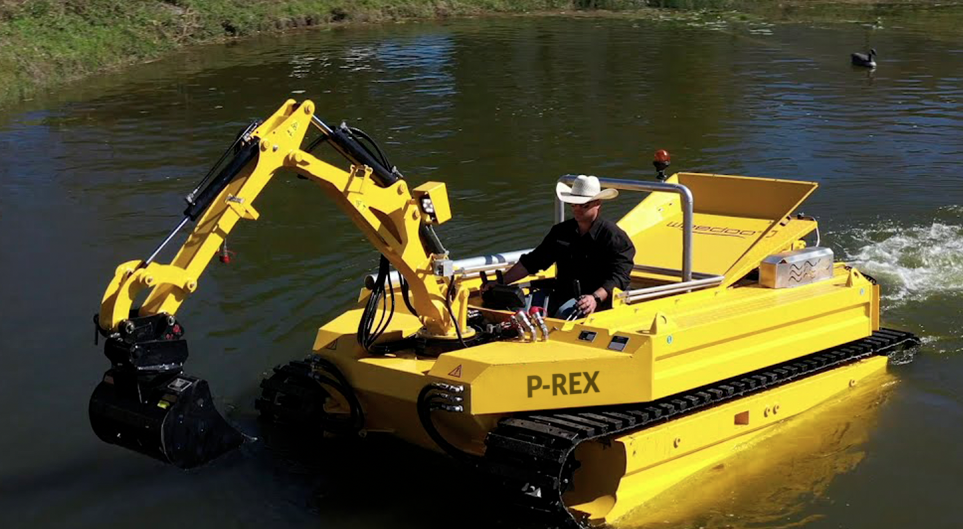
EQUIPMENT TECH SHEETS
Invasive Weed Removal
Engine:
4 Cylinder Diesel
55 kW / 75 Hp at 2200 RPM
Battery:
12V, 88 Ah Electrical Control System
Diesel Fuel Tank:
16 gal. (60 l)
Dimensions (Overall):
Length: 19'8''
Width: 7'9''
Height: 6'7’’
Dimensions (Hull):
Length: 12'6''
Width: 4'1''
Height: 4'8''
Draft:
Approx. 21'5’’
Ground Clearance:
Approx. 16’’
Propulsion in Water:
Hydraulic Weed-Free Augers with Adjustable Depth and Tilt
Driving on Land:
Tracks Fitted Around Pontoons
Speed:
Variable, up to 3.75 mph on Water and Land
Working Boom:
7'10'' Reach
270° Swing Radius
Quick Change System
P-REX
· Extremely Versatile
· No Ramp Needed
· Weed Harvesting
· Cattail Removal
· Shoreline Edging
Copyright 2023 Paragon ISG Company. All rights reserved.
Increased headcount from 72 to 92

Slide 11
DREDGING?
Copyright 2023 Paragon ISG C-ompany. All rights reserved.

Slide 12
WHAT PEOPLE THINK OF
Copyright 2023 Paragon ISG C-ompany. All rights reserved.

Slide 13
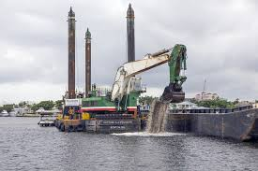
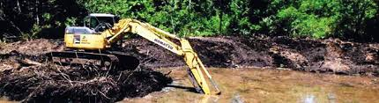
Most people think of Mechanical Dredging
Copyright 2023 Paragon ISG Company. All rights reserved.
Increased headcount from 72 to 92

Slide 14
THE PARAGON DIFFERENCE:
Hydraulic Dredging
Copyright 2023 Paragon ISG C-ompany. All rights reserved.

Slide 15

Copyright 2023 Paragon ISG Company. All rights reserved.

Slide 16
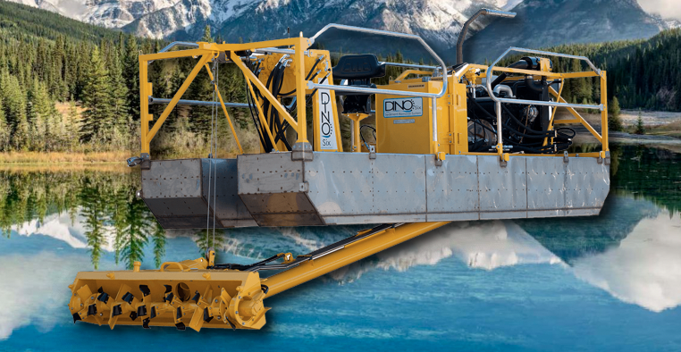
EQUIPMENT TECH SHEETS
Hydraulic Dredging
Dimensions:
Length: 21’
Width: 8’
Height: 5’ above waterline
Weight (Less Fuel): 3,800 lbs.
Slurry Pump:
Material: AR Steel, 400-500 Brinell
Discharge Diameter: 6 in.
Performance: 1,500 GPM Max, 1,100 GPM @ 50 ft. TDH
Impeller: Open Faced Trash (Enclosed Impeller Available)
Engine:
Type: B3.3 Cummins, 4 Cylinder Diesel
Horsepower: 65 hp @ 2500 rpm
Fuel Capacity: 30 Gallons
Hydraulic System:
Pump: Tandem Gear 2.60 in³/rev. and 0.91 in³/rev.
Filtration: 10 Micron
Reservoir: 25 Gallons
Features: Oil Cooler (Thermostatically Controlled), Stainless Steel Tubing on Boom, Impeller High-Low Speed Selector Valve
Working Capacity:
Working Depth: 13 ft.
Cut Width: 66 in.
Travel System:
Dimensions: 21 ft. x 71 in. x 64 in.
Windlass: Double Pulley Hydraulic with 2 Hydraulic Motors
Para 6 Dredge
· Portable hydraulic dredge
· Equipped with a 6-inch submersible pump and
66-inch-wide cutter head
· Ideal to remove accumulated sludges and
sediment from a body of water
· Perfect for containment and decorative ponds,
lakes and marinas
Copyright 2023 Paragon ISG Company. All rights reserved.
Increased headcount from 72 to 92

Slide 17
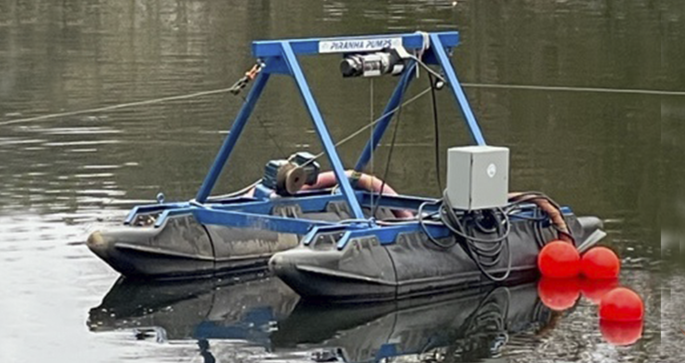
EQUIPMENT TECH SHEETS
Hydraulic Dredging
Mini-Dredge
Platform:
Length: 18’3”
Width: 8’
Height: 9’10”
Total Weight: 3800 lbs.
Draft: 12 inches
Pontoons:
Ultra High Molecular Polyethylene
Modular/Foam Filled
Excavation:
Excavation Depth: 0-40 feet
Traverse Speed: 0-38 fpm
Dredge Pump:
Type: Severe Duty Slurry/Agitator
Motor:
20 hp, 1170 RPM, 460v
Service Factor: 1.35
Max. Spherical Solids:
1.5 inch
· Retention Ponds
· Digester Tanks
· WWTP Lagoons
· Farm Slurry/Ash Ponds
Copyright 2023 Paragon ISG Company. All rights reserved.
Increased headcount from 72 to 92

Slide 18
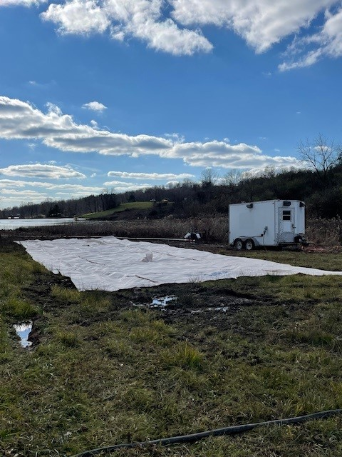
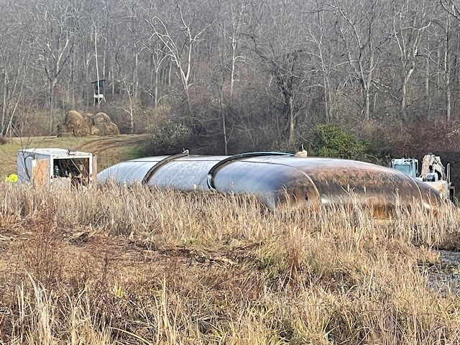
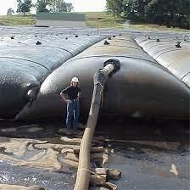
Dewater Bag Option
Pros- Less mobilization required vs. mechanical separation equipment.
Cons- With large volumes of sediment, this option requires significant land for deployment. Requires 45-60 days for dewatering prior to relocation of solids. Requires additional mobilization of equipment for solids disposition.
Copyright 2023 Paragon ISG Company. All rights reserved.
Increased headcount from 72 to 92

Slide 19
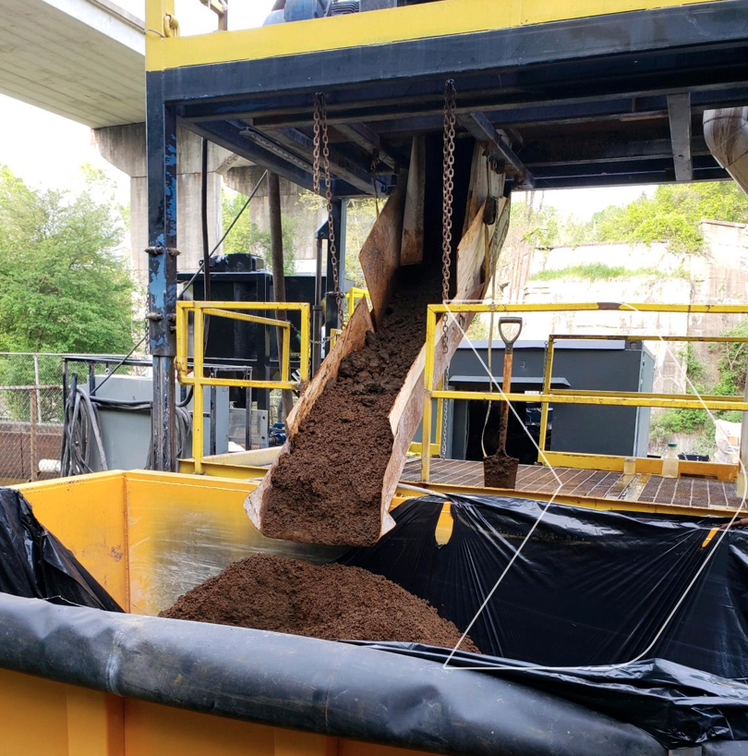
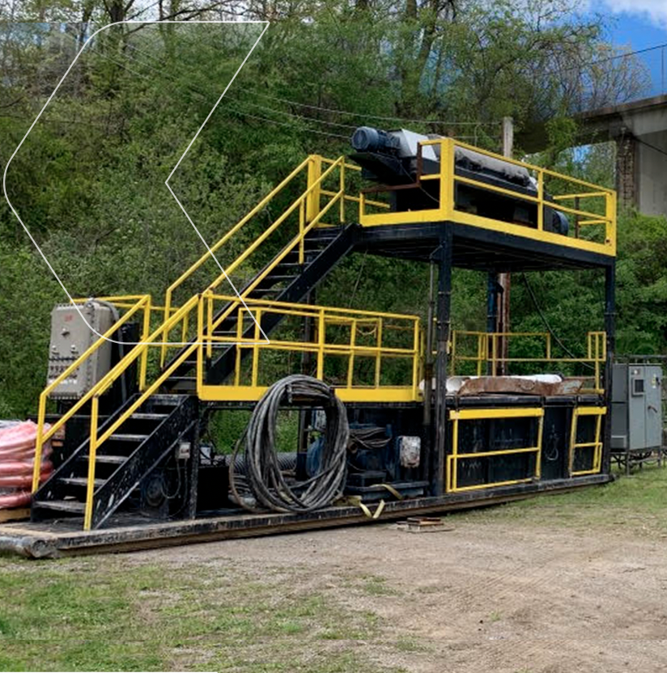
DEWATERING SERVICES
On-Site Dewatering
Paragon ISG's dewatering services deliver unparalleled efficiency and safety in the oil and gas industry, leveraging advanced technology to optimize fluid management while championing environmental sustainability.
Our solutions minimize environmental impact, reduce operational costs, and ensure compliance with regulatory standards, making us a trusted partner in fluid management.
We can design a dewatering system that is small in footprint and large in capacity that can be tailored to any kind of project.
RAPID DEPLOYMENT SMALL FOOTPRINT IMMEDIATE DISPOSAL CLEAN WATER RETURNS
Copyright 2023 Paragon ISG Company. All rights reserved.
Increased headcount from 72 to 92

Slide 20
PROJECTS
Copyright 2023 Paragon ISG Company. All rights reserved.

Slide 21
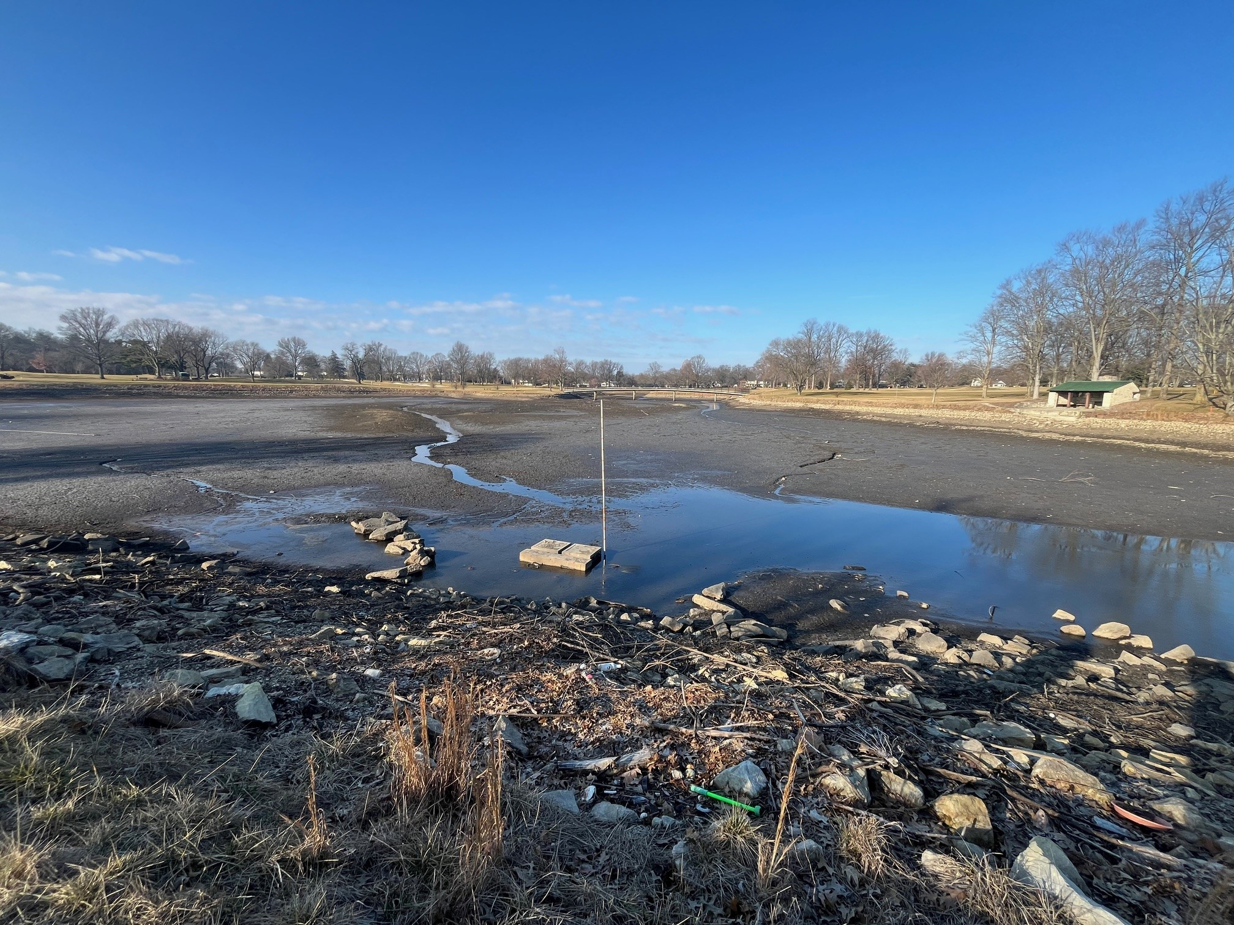
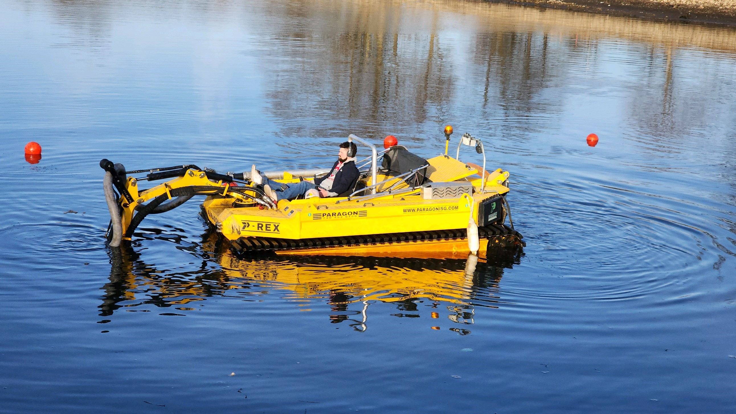
Ohio State University Golf Club
Emergency Sediment Relocation Project
Could not use mechanical equipment due to sinking
Used baffle curtain to create a cofferdam for spoils relocation area
3 days onsite. Provided a relief area 5ft below the intake with a 70 ft radius.
Copyright 2023 Paragon ISG Company. All rights reserved.
Increased headcount from 72 to 92

Slide 22
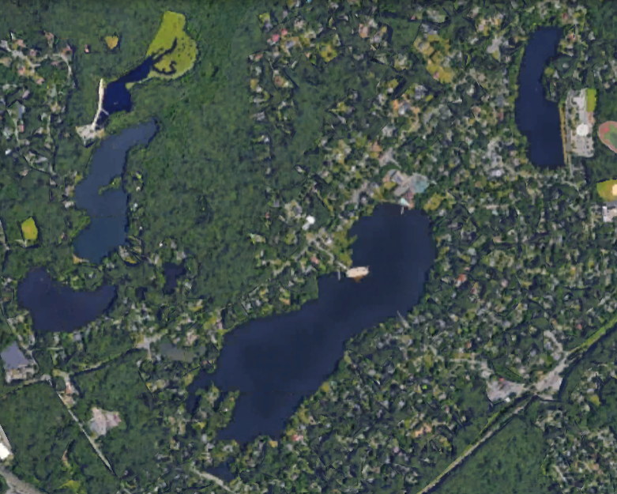
Mountain Lakes, NJ
Hydro-Raking & weed harvesting. Homeowner projects.
One month/summer with P-Rex, Brontosaurus and Megalodon
Clean organic materials that accumulate in shallower coves.
Harvest invasive weeds in two areas that have shallow depth
Partnership with the Borough- Paragon transports all material to designated area at shoreline and city personnel haul to community dump site for composting at later date
2024 work began April 1. Birchwood Lake – 10 days producing approximately 150 CY of organic matter removed
Copyright 2023 Paragon ISG Company. All rights reserved.
Increased headcount from 72 to 92

Slide 23
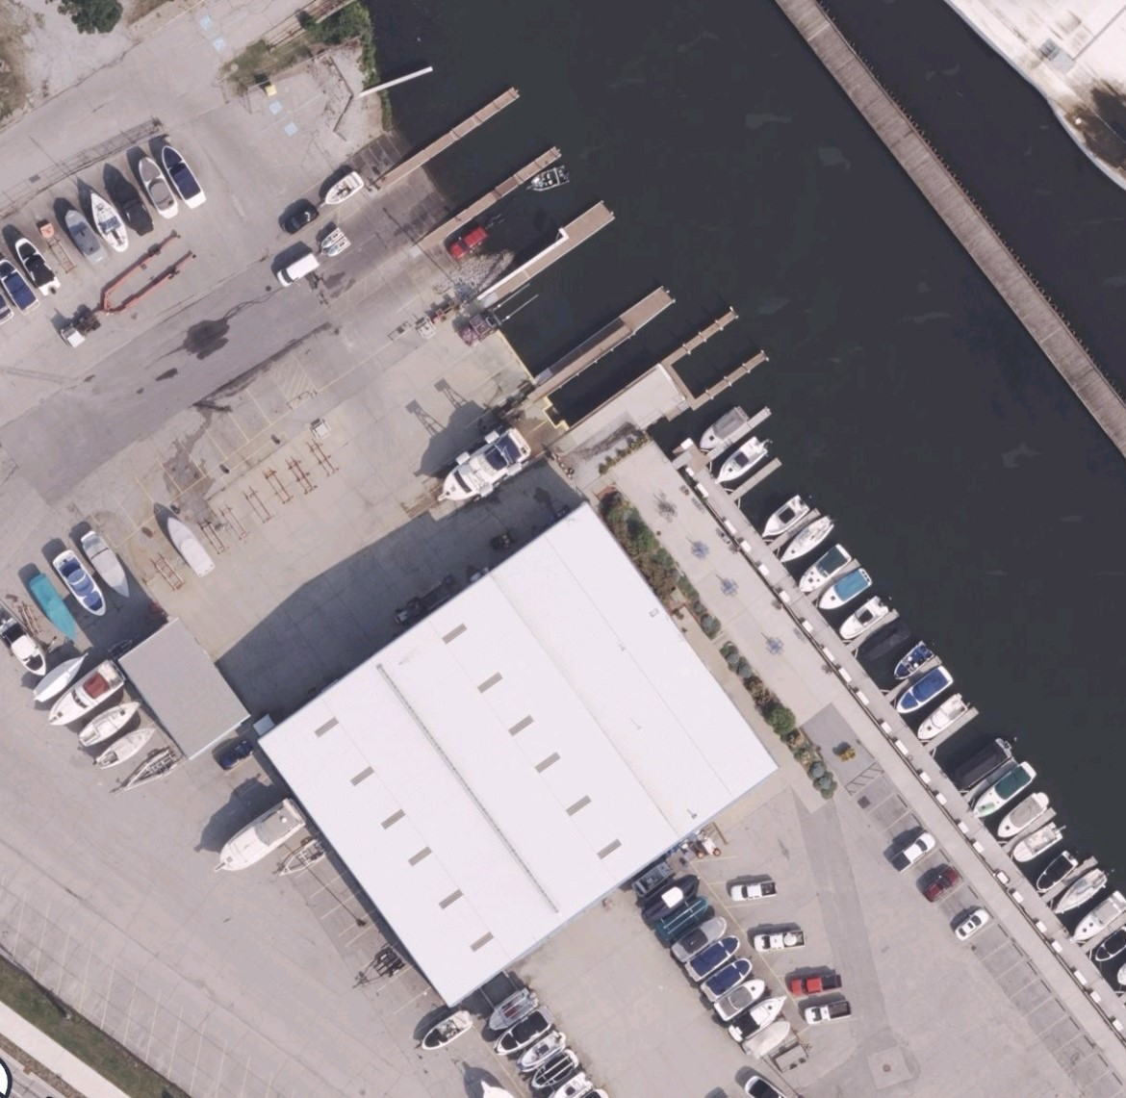
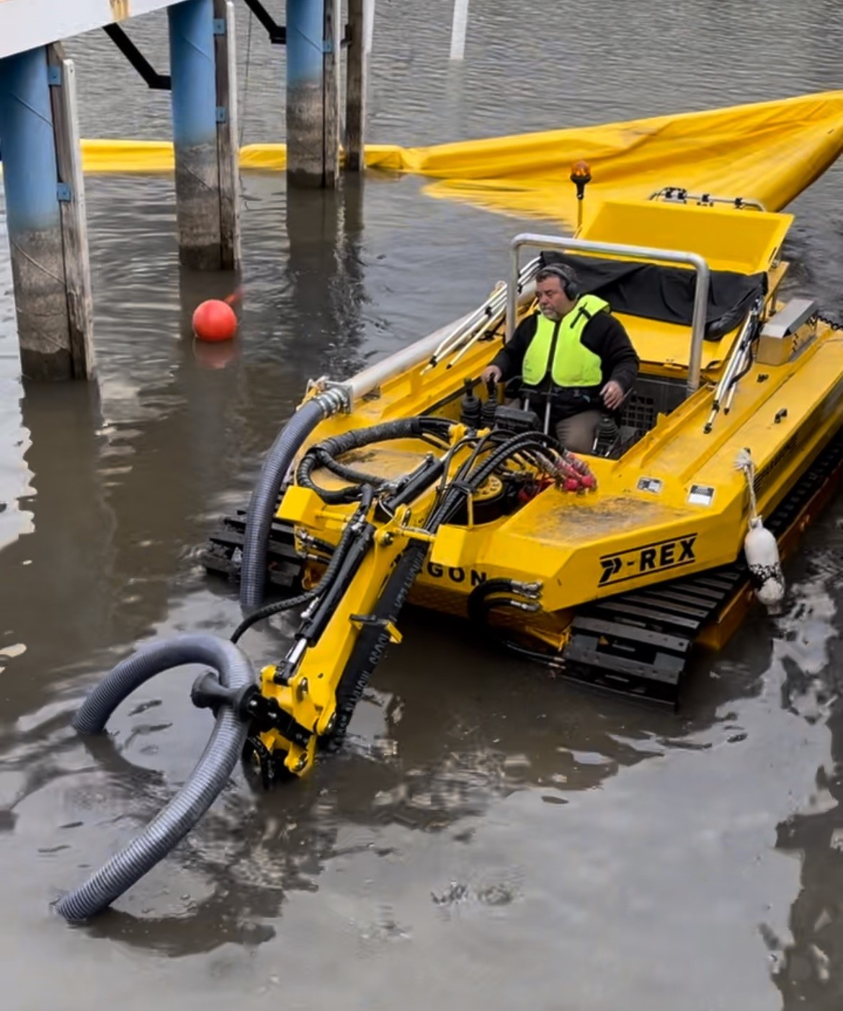
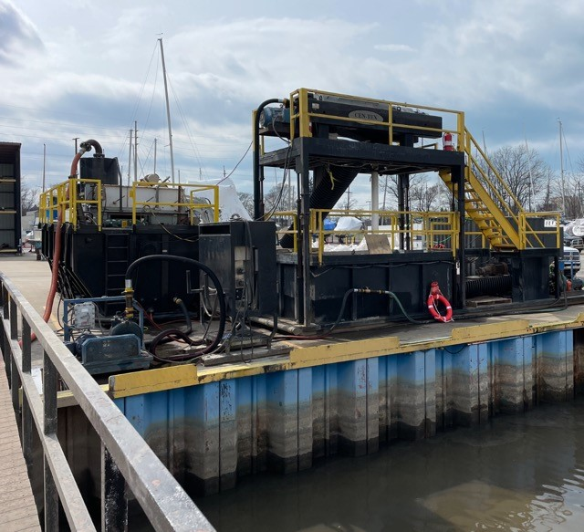
Michigan City Marina
Customer had boat lifts that had accumulated several feet of muck
Live well project adjacent to Lake MI with an active salmon run during the spawn. Curtailed hours of operation to avoid the spawn.
Paragon used the P-Rex with dredge pump to hydraulicly removed muck and return slips to as built surface levels.
Paragon cleaned the liquid and removed solids via a centrifuge, down to below 5 microns in particle size.
The centrifuged solids were dry enough for roll-off box disposal.
Copyright 2023 Paragon ISG Company. All rights reserved.
Increased headcount from 72 to 92

Slide 24
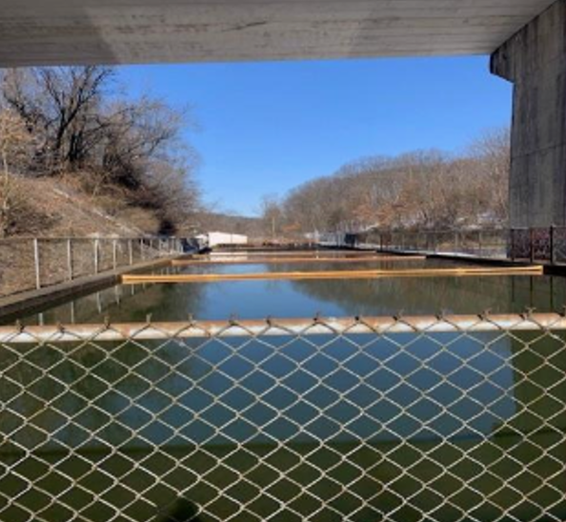
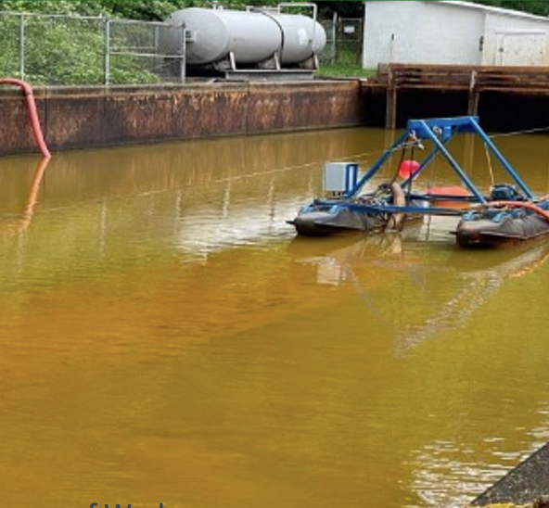
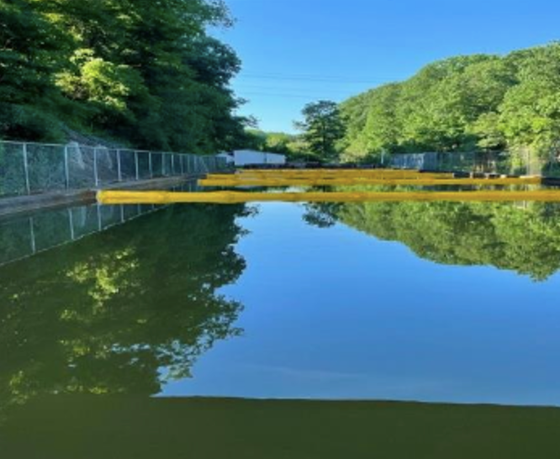
Pennsylvania DEP AMD Wildwood Lagoon Cleanout
Scope of Work:
Remove 4.25' of sludge from 246' x 46' lagoon.
Transport sludge to approved landfill.
Dewater sludge; recover fluid at max 800gpm.
Ensure fluid cleanliness to protect wildlife and high-profile trout river.
Remove and dispose of old aeration system.
Replace 5 baffle UV curtains and anchors.
Restore disturbed earth to original condition.
Work Performed:
Active processing lagoon with ground water flow of 600 gpm from a former coal mine as eviodent from the sulphur & iron content. Discharge into PA stocked trout stream.
Used mini hydraulic pump dredge to remove sludge.
Processed sludge with environmentally safe flocculant and high-speed centrifuge.
Returned clean fluid to outflow at 120 gpm.
Eliminated need for solidifier due to effective centrifuging.
Achieved 65% reduction in sludge volume sent to landfill.
Replaced UV baffle curtains and installed new turnbuckles.
Copyright 2023 Paragon ISG Company. All rights reserved.
Increased headcount from 72 to 92

Slide 25
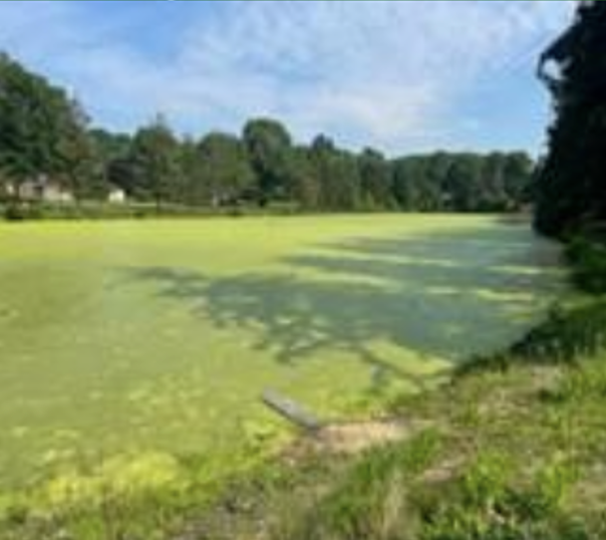
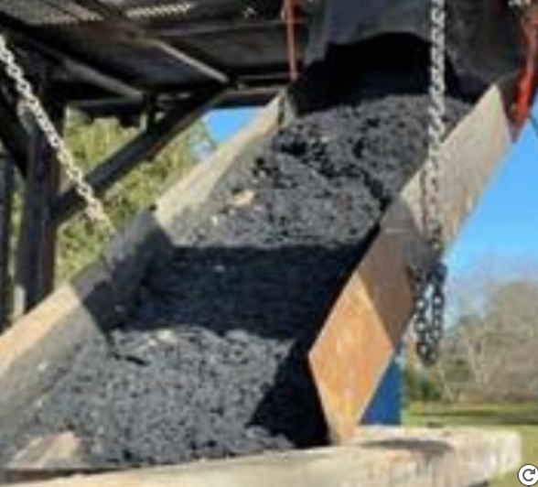
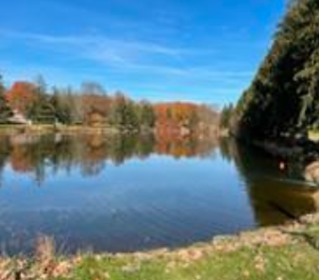
New Philadelphia Stormwater Retention
Scope of Work:
Remove all duckweed and surface vegetation for cosmetic clean up.
Dredge 18" of stormwater sediment from lagoon floor, preserving aquatic wildlife.
Maintain lagoon operations during process.
Transport sludge via city trucks to city-designated repurpose site.
Clean, reseed disturbed property to original condition.
Work Performed:
Deployed mini hydraulic pump dredge to remove 18" of silty sediment from stormwater lagoon.
Processed sludge and vegetation through shale shaker to remove large particles.
Skimmed duckweed from water surface, preparing for future chemical treatment.
Dewatered sludge using a high-speed centrifuge.
Applied food-grade anionic polymer to protect aquatic ecosystem.
Dried sludge and duckweed for immediate transport to city-approved repurpose site.
Copyright 2023 Paragon ISG Company. All rights reserved.
Increased headcount from 72 to 92

Slide 26
The way we work with our clients
Customer-centric: Paragon ISG Environmental Team continues to build our services around the unique demands of our clients, with a deep insight into your environmental challenges. We're committed to providing you with solutions that are a perfect blend of sustainability and operational excellence, ensuring your projects stand out in the industry.
Results-driven: We believe that our cutting-edge water management solutions, ranging from treatment to conservation strategies, will not only ensure your operations are compliant with environmental standards but will also drive significant cost savings and efficiency for your projects.
Copyright 2023 Paragon ISG Company. All rights reserved.

Slide 27











TRUSTED BY
Copyright 2023 Paragon ISG Company. All rights reserved.

Slide 28
QUESTIONS?
Todd Watkins
twatkins@paragonisg.com
Dan Mount
dmount@paragonisg.com
Copyright 2023 Paragon ISG Company. All rights reserved.

Slide 29

THANK YOU!
Copyright 2023 Paragon ISG Company. All rights reserved.

