Slide 1
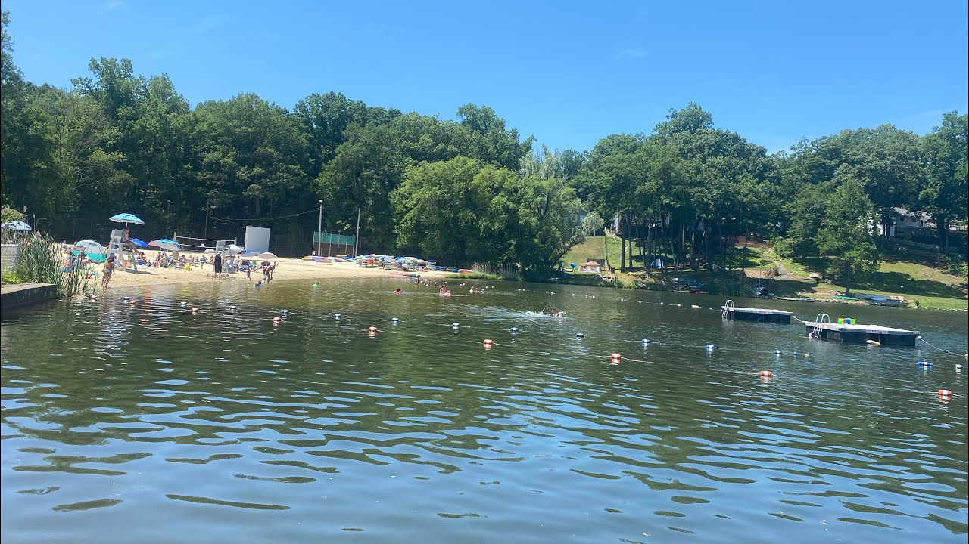
WATERFRONT UPDATES 2024
NJ COALITION OF LAKE ASSOCIATION

Slide 2
2024 Topics
New Red Cross Lifeguard course
NJ PRB- Requirements
PRB Proposals from COLA
New Boating Regulations
Annual Aquatic Safety Seminar
Lifeguard Management & Pool Director certification
Training Opportunities

Slide 3
NEW RED CROSS LIFEGUARDING COURSE
New updated course is in effect as of February 2024.
All Lifeguard Instructors must update to the new course materials by August 31, 2024. After that, they cannot teach the old course and must teach the new one from then on. If LGIs do not update, they can no longer teach Lifeguarding classes until they get re certified.
Current r.17 course may be taught up to August 31st. Certifications will be still be valid for 2 years. (2026).

Slide 4
NEW RED CROSS LIFEGUARDING COURSE Changes
New pre requisite test- Swim/Tread/Swim
(300 yd swim/tread 2 minutes/250 swim)
Updates on CPR and First Aid
More emphasis on:
surveillance,
zone validation,
team response.

Slide 5
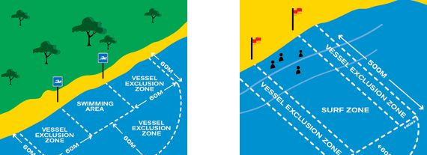
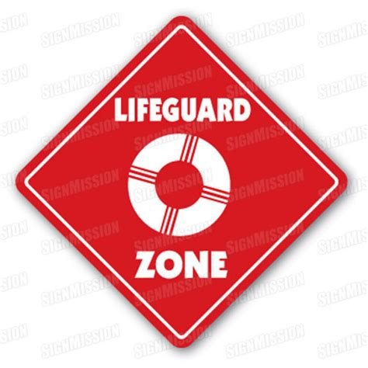
NJ Public Recreational Bathing Code (PRB)
ZONE TESTING AND VALIDATION- Required under the PRB
Test zones of protection/surveillance area of what lifeguards can see and respond to within 30 seconds to the furthest part of their zone.
Validate it at different times of day, week, etc.
Document by diagram, testing and recording.

Slide 6
NJ PRB- IN-SERVICE TRAINING REQUIREMENTS

Slide 7
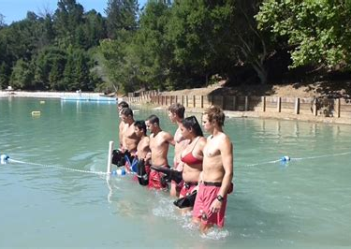
IN-SERVICE TRAINING
REQUIRED IN-SERVICE TRAINING (Minimum is 4 hours per month)
DOCUMENTED- have sign in sheets, lesson plans, reference material.
SUBJECT MATTER EXPERTS (SME) – Can use outside instructors/agencies, ie. EMS, Fire Department, Health Dept.
TRAIN WITH NON AQUATIC STAFF

Slide 8
In-Service Training Suggestions
Conduct a drill with your local EMS and Police Department
Conduct a drill with your Lifeguards, gate personnel, camp counselors, office staff, maintenance, even members.
Always train with site specific equipment, ie. Paddleboards, boats, ring buoys, etc.
Conduct drills during open hours with members/patrons present.

Slide 9
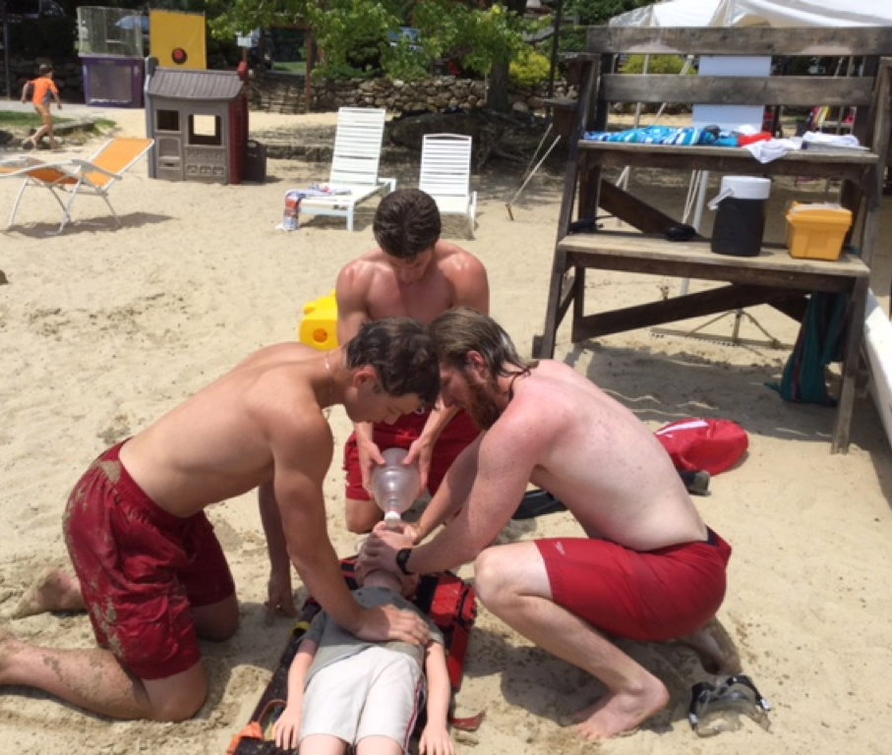
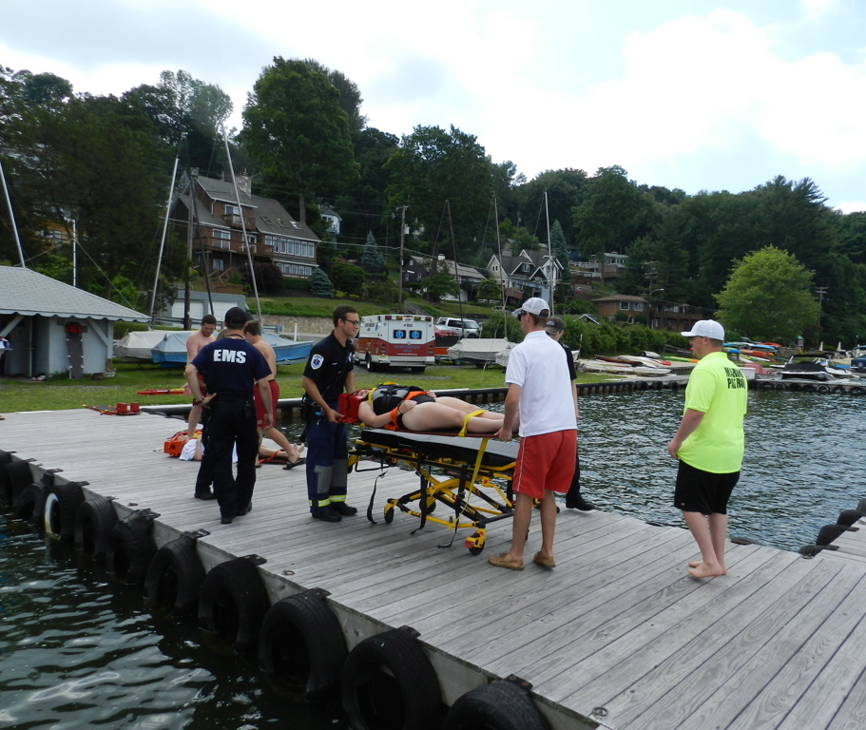
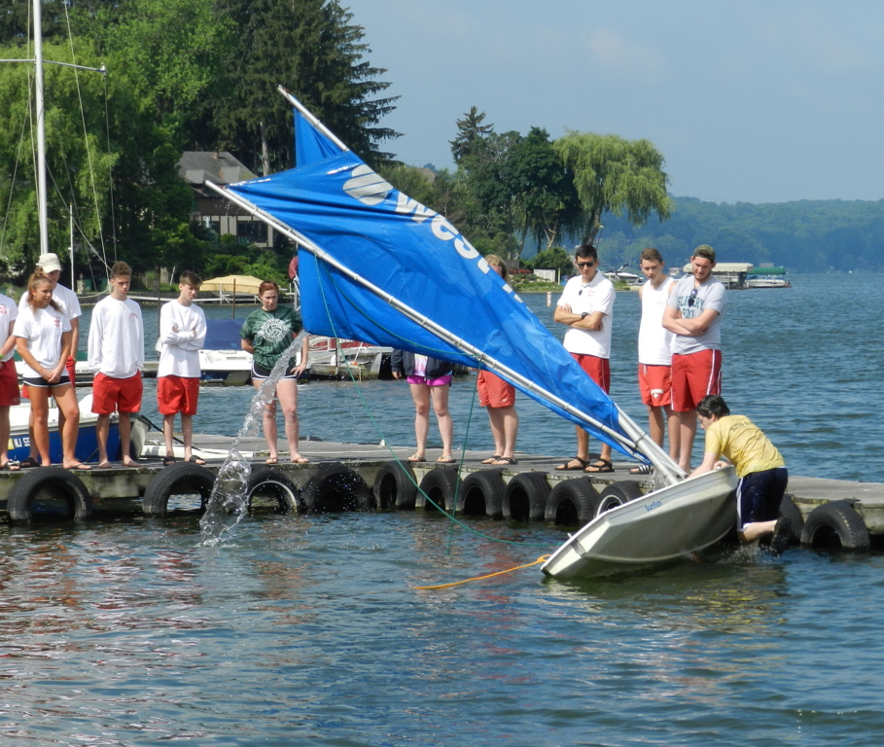
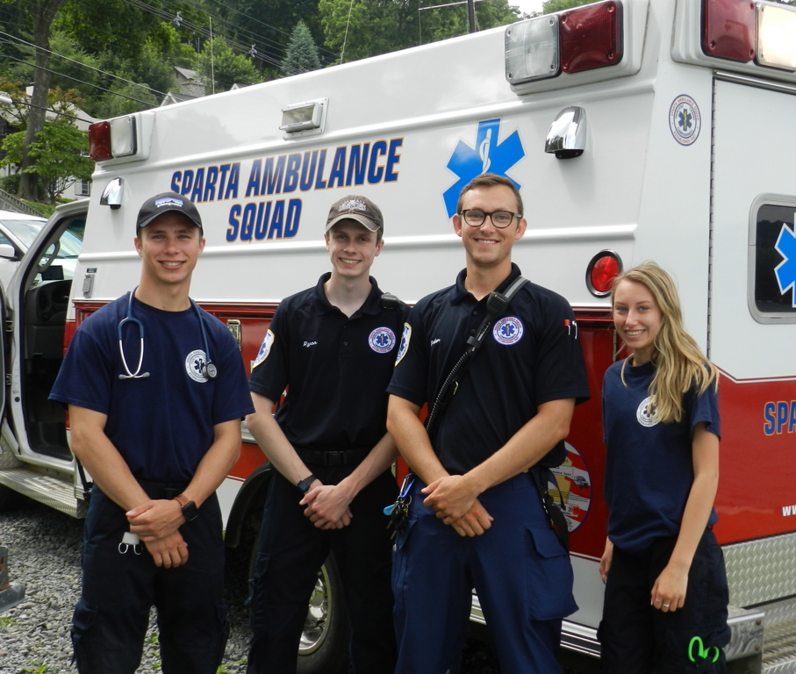
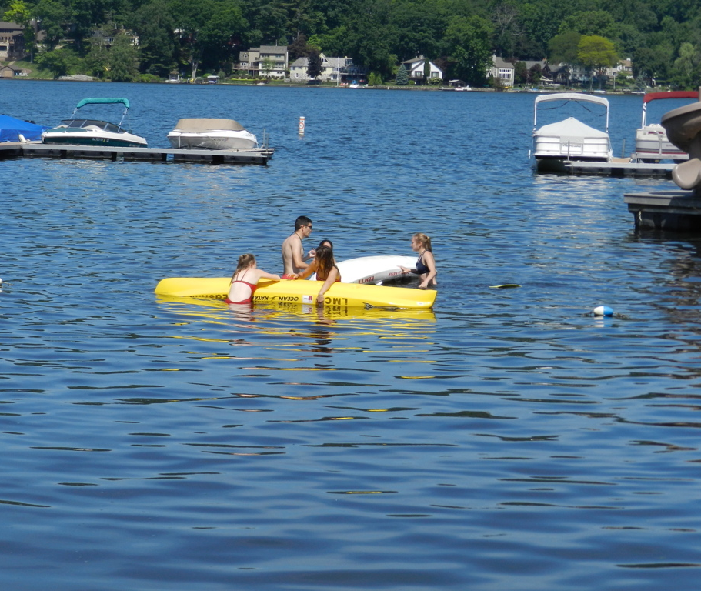
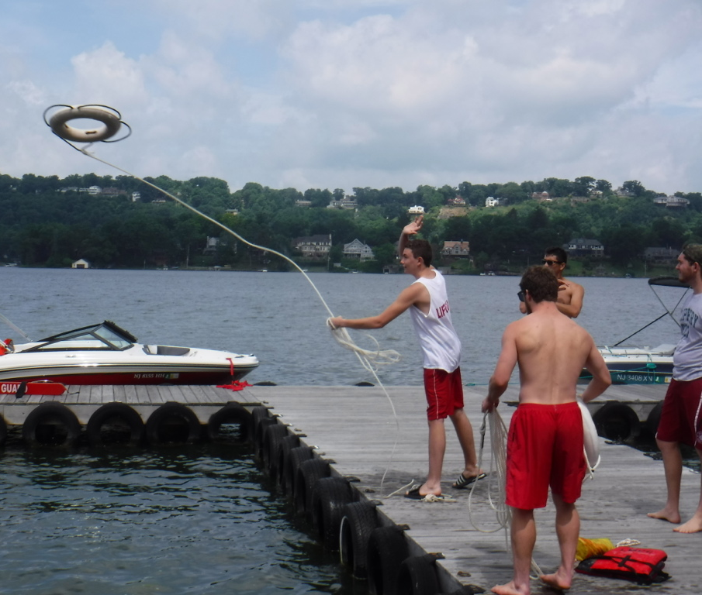

Slide 10
New Proposals to PRB from COLA
Proposing change in regulation regarding lifesaving equipment specifically for member only lake waterfronts.
Proposing change in regulation regarding requirement for Pool Director certification to apply to all waterfront directors.

Slide 11
PRB Scope
§ 8:26-1.1 Purpose
The purpose of this chapter is to set reasonable sanitary and safety regulations for public recreational bathing facilities and to preserve and improve the public health in this state as provided for in N.J.S.A. 26:1A-7.
§ 8:26-1.2 Scope
These rules shall govern all public recreational bathing facilities in New Jersey. Pursuant to N.J.S.A. 26:1A- 9, the provisions of this chapter are enforceable by the New Jersey Department of Health, local health authorities, local police authorities, local sheriff's departments, and other enforcement agencies.

Slide 12
"Bathing beach" means the designated area of a natural or artificially constructed pond, lake, stream, river, bay, tidal waters, ocean or other body of fresh or salt water, which is used for bathing and swimming purposes together with buildings, equipment, and appurtenances, if any, and the land areas used in connection therewith.
"Public recreational bathing facility" means any bathing beach, hot tub, spa, swimming pool, wading pool, and aquatic recreation facility that includes State, county, and municipal facilities, as well as any beach that an owner or operator permits for use as a public swimming area through advertising, publicity, or designation. Public recreational bathing facilities do not include a non-bathing beach and/or a private recreational bathing facility.

Slide 13
"Specially exempt facility" means a public recreational bathing facility that is:
1. A private lake, river, or bay or private community lake, river, or bay association, or private nonprofit common interest community that restricts the use of its lake, river, bay, or pool, as appropriate, to the owners of units thereof and their invited guests;

Slide 14
Request for change in N.J.Public Recreational Bathing Chapter 26.
The New Jersey Coalition of Lake Associations is comprised of over 85 private lake communities with approximately members using these lakes.
A majority of these communities are relatively small in population averaging about ………..each.
Almost all of these lake communities provide bathing beaches for their members and adhere to the NJ PRB as specially exempt facilities. These lakes are only open and available to their property owners, members and invited guests. They do not advertise nor solicit to the public as open to the general population.

Slide 15
These lake communities provide for their members and property owners by adhering to the NJ PRB, especially in the areas of sanitation, water testing, and safety.

Slide 16
Rationale
Some of our member lakes find it difficult to provide lifeguard and first aid personnel at all times. Some choose to provide Lifeguards only on weekends and holidays. This could be due to budget constraints and/or shortage of qualified Lifeguard personnel.
All lake communities that provide lifeguard services at any time, whether regular or special hours, readily comply with the NJ PRB required lifesaving equipment, certification and staffing.
However, the requirement to provide all lifesaving equipment at these beaches at when lifeguards are not present is neither safe nor cost effective.

Slide 17
Rationale continued
Equipment unattended such as spine boards, rescue tubes, rescue watercraft, to untrained people could cause a false sense of security and potentially harm both any victim and good Samaritan.
Local Health Inspectors charged with the responsibility to inspect aquatic facilities seem to lack the knowledge and education pertaining to lifeguarding and lifesaving equipment. Some Health Inspectors have readily admitted that they have no idea on how or when to use the very equipment that they are responsible to inspect.

Slide 18
COLA Recommendation
NJ COLA recommends that in lieu of leaving out all rescue and first aid equipment, that all bathing beaches, supervised or unsupervised by Lifeguards, have at least one ring buoy with a 60 foot line attached along with signage designating: “For Emergency Use Only, Reach, Throw, Go Call 9-1-1.” The signage should also list the location of the bathing beach. The ring buoy should be in place at all times 24 hours per day.

Slide 19
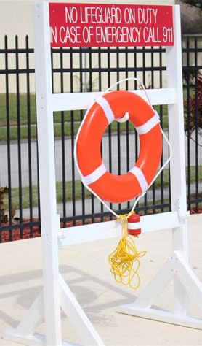
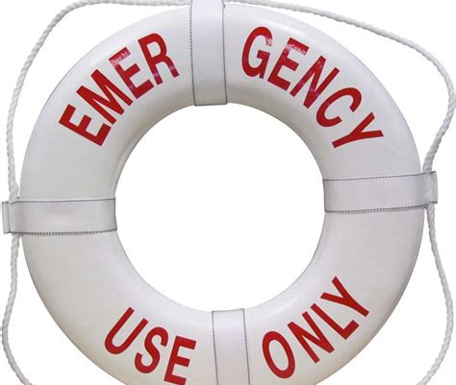
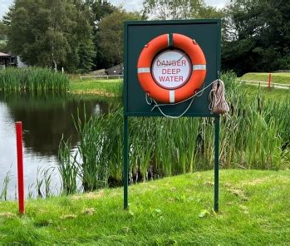
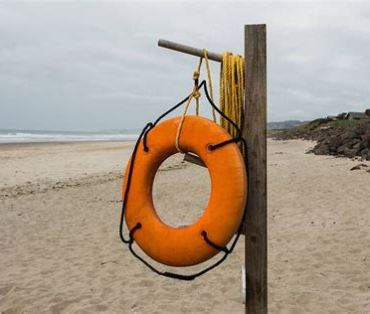

Slide 20
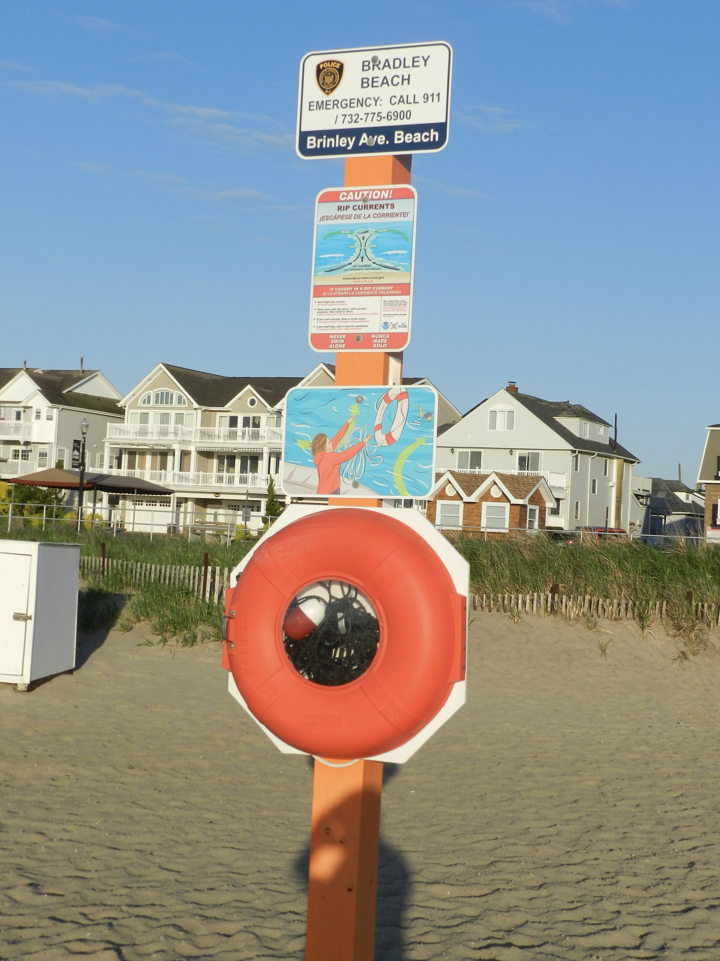
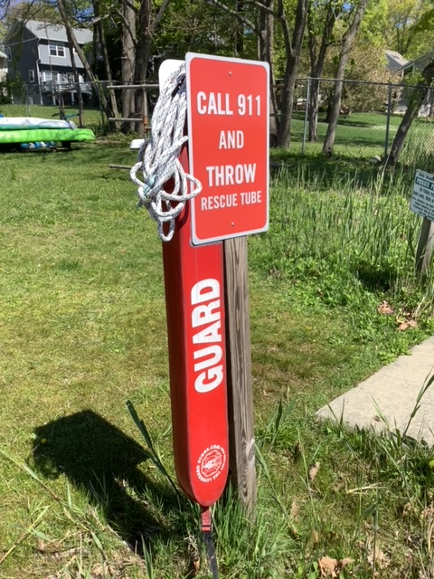

Slide 21
Health Code Regulations
Required Documentation
Water samples
Lifeguard certifications - CPR/First Aid & Waterfront Lifeguarding
Emergency Action Plans
Site diagrams

Slide 22
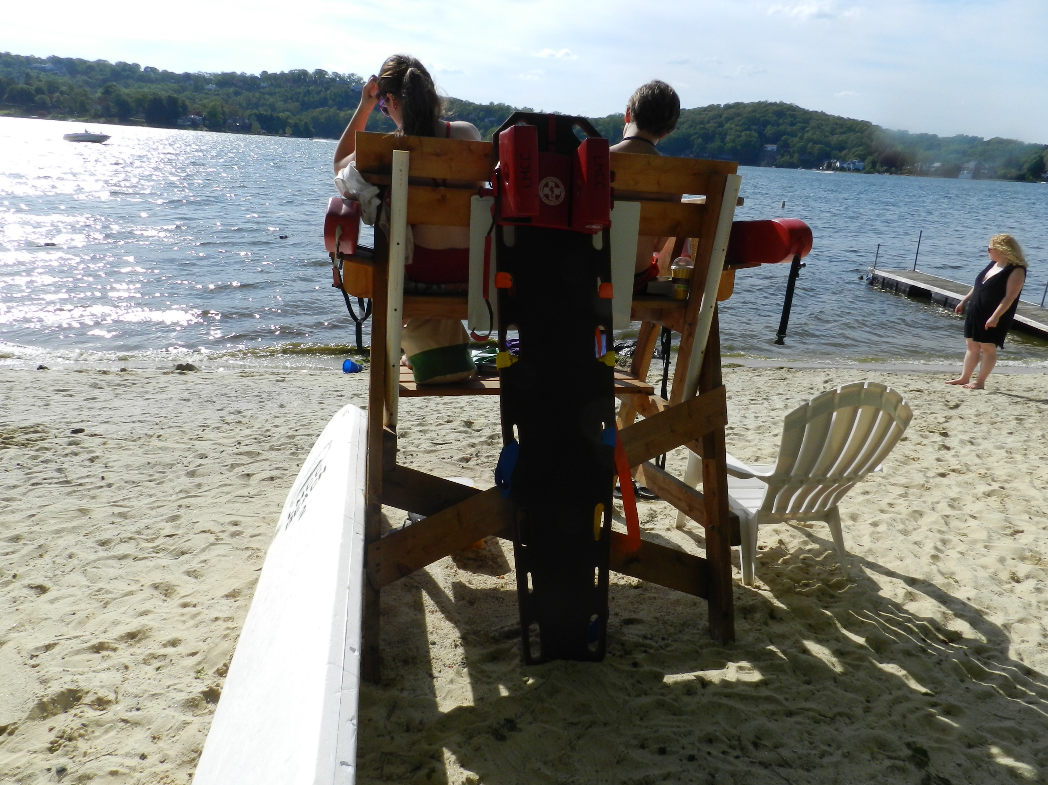
Equipment
What is required by local or state regulation?

Slide 23
Required Equipment
Rescue Tubes
Ring Buoy
First Aid Kit
Telephone
Back board
AED

Slide 24
BATHING BEACH SUPERVISION
Proposed change/amend to NJ PRB
The NJ PRB requires training and certification as a Pool Director. This certification is for standard pools only. The American Red Cross Lifeguard Management course with the supplemental proctored in person written exam is approved to satisfy this certification under the PRB. Our recommendation is to extend this required certification to all aquatic facilities operators, ie. Waterfront directors. This course includes extensive information on the NJ PRB and is valuable to all aquatic facilities, not just pools.

Slide 25
Bathing Beach Supervision
§ 8:26-5.10 Bathing beach supervision
A bathing beach shall be under the supervision of a designated adult supervisor. (THE ADULT SUPERVISOR SHALL MEET ALL OF THE REQUIREMENTS OF THOSE DESIGNATED AS A POOL DIRECTOR AND SHOULD BE DESIGNATED AS WATERFRONT DIRECTOR).
Currently under the PRB, all pool directors must be certified in Lifeguard Management AND successfully pass a NJ State In Person Exam.

Slide 26
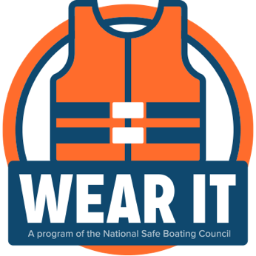
NEW BOATING REGULATIONS
Mandatory Winter PFD Wear
New Regulation 13:82-1.4(f)
Starting November 1, 2023, no owner or operator of a recreational vessel less than 26 feet, including rowboats, canoes, kayaks, and stand-up paddleboards shall permit its operation between November 1st and May 1st, unless each person on board such vessel is wearing a securely fastened United States Coast Guard-approved wearable personal flotation device of an appropriate size while such vessel is underway. A person inside the cabin of a cabin vessel shall be exempt from this requirement.
In short, A USCG approved life jacket is required to be worn at all times, outside of a cabin on a boat under 26 feet during the cold-water months, while in motion, from November 1st to May 1st.

Slide 27
Revised Boating Regulations
(b) All power vessels (including vessel, towline, and skier) conducting
waterskiing operations, including wake surfing, shall, while underway,
keep at least 200 feet distant from any wharf, marina, dock, pier, bridge
structure, abutment, [or] persons in the water, [and 100 feet from] other
vessels, any shore, approved aid to navigation, or mooring, except
specifically provided otherwise in this chapter.

Slide 28
Annual Aquatic Safety Seminar
Monday, April 29, 2024,
6:00-8:30 PM
at Lake Mohawk Country Club

Slide 29
Lifeguard Management & NJ Pool Director Certification
TUESDAY, APRIL 30, 2024
6:00-8:30 PM
AT LAKE MOHAWK COUNTRY CLUB
PRE REGISTRATION IS REQUIRED
Contact Rich Carlson at
njaquaticsafetycoalition@gmail.com

Slide 30
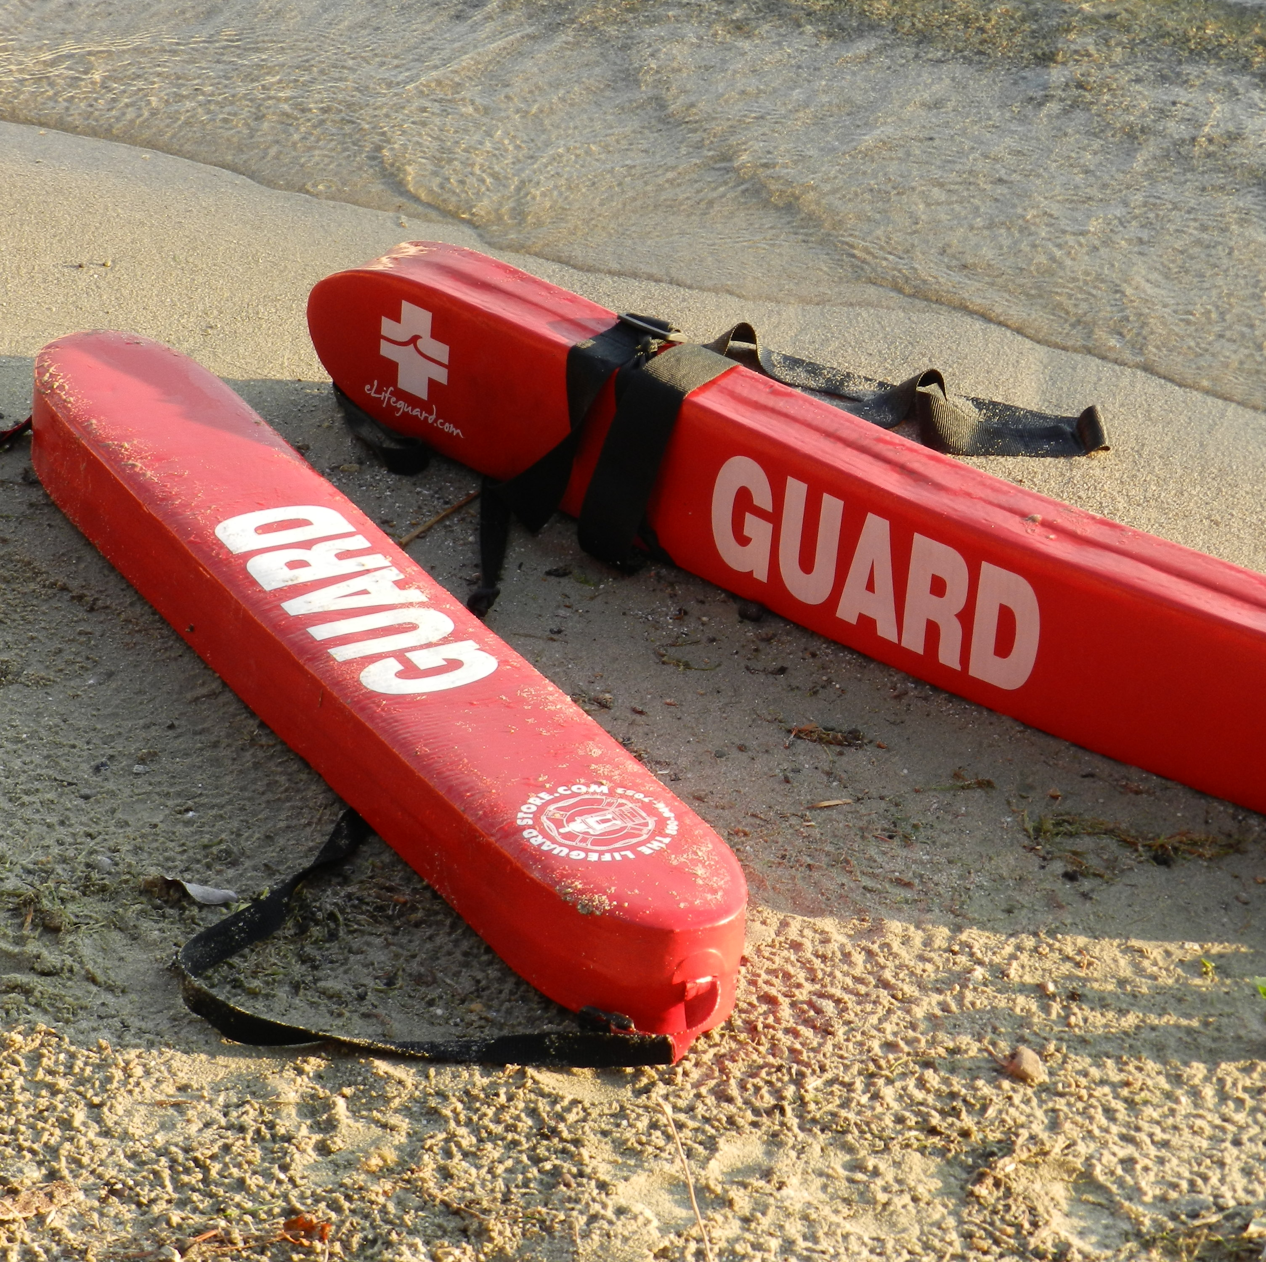
TRAINING OPPORTUNITIES
Basic Waterfront Lifeguarding
Lifeguard Re certification classes
In-Service Training Schedule
Schedule and prices to be available by the April COLA meeting.

